Slide 1
Actors and Akka PRESENTATION – Vermont Code Camp 2019 Mary Grygleski Twitter: @mgrygles IBM Developer Advocate Java & Reactive Grant Steinfeld Twitter: @gsteinfeld IBM Developer Advocate JVM & Blockchain

Slide 2
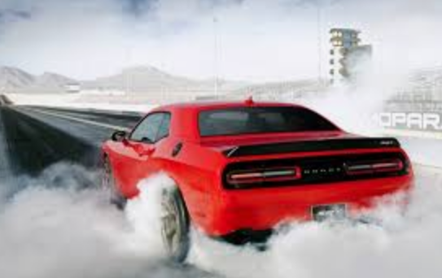
Challenges for the modern technologist
Create fast fault tolerant internet scale cloud systems to handle millions of transactions per day!

Slide 3
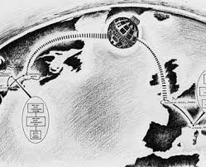
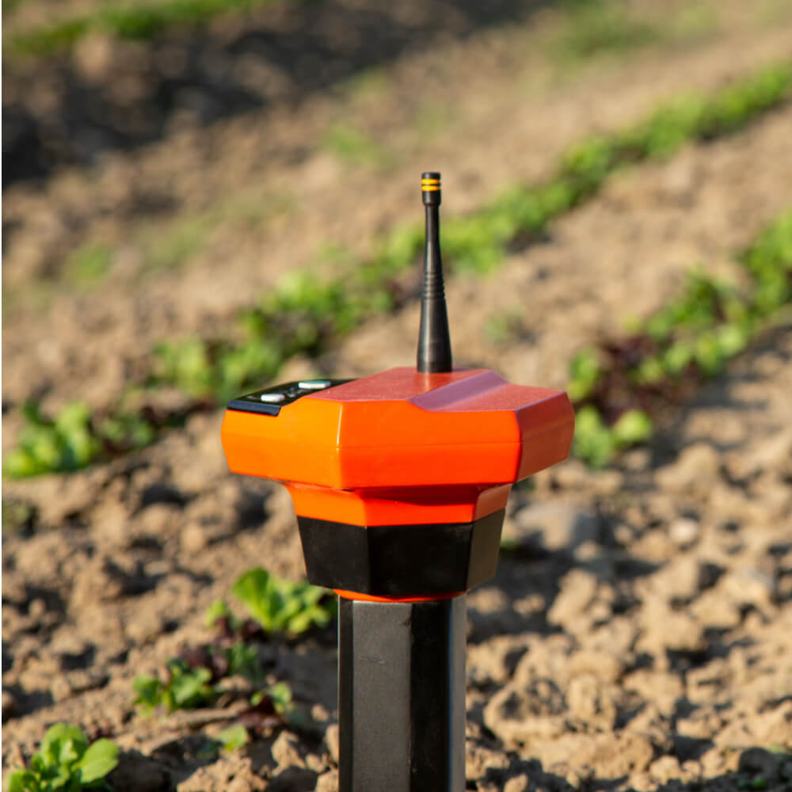
Smart Farming - Data Streaming Processing Hypothetically an IoT sensor metric real-time aggregator ~ 10 Million sensors – gps/temp/soil moisture ~ Million messages/minute ~ 99.999% reliability - Fast remote analysis and response
Massive System Example
Notes:
Data in motion – streaming!!!
Paypal
Verizon

Slide 4
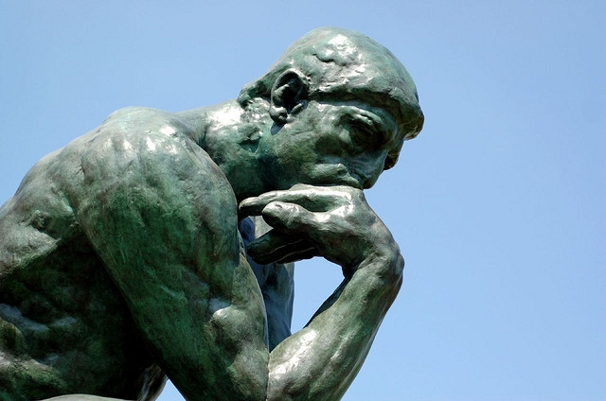
How do we build such a system?
Best fit Technology Stack
Architectural alternatives
Team size, skillset
Willingness to leave comfort
zone

Slide 5
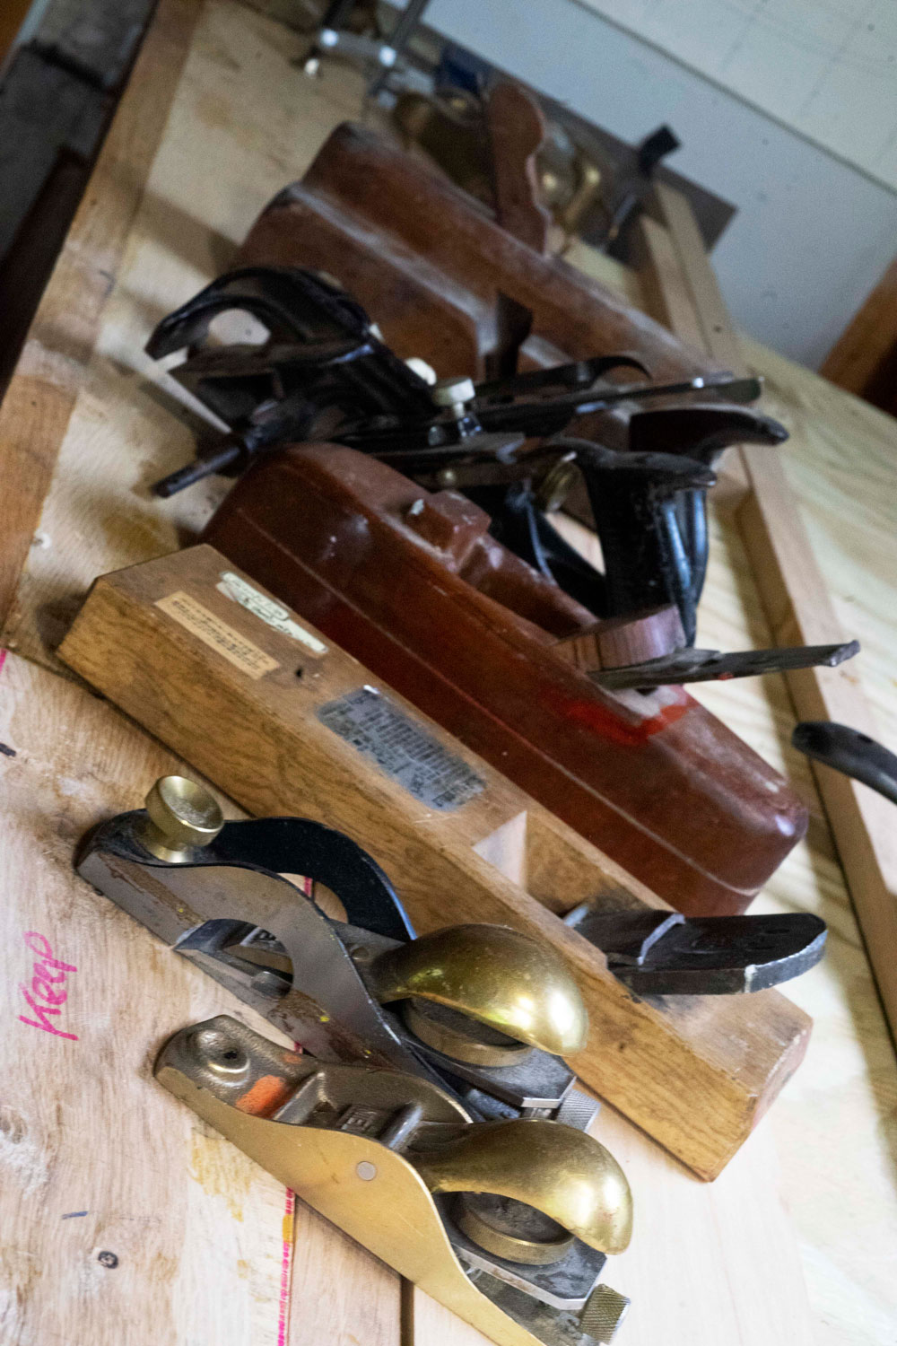
REACTIVE ARCHITECTURE
ACTOR MODEL OF COMPUTATION
AKKA
KUBERNETES
Notes:
Agenda today

Slide 6
Reactive Systems
Notes:
Model of Computation

Slide 7

What is Reactive?
The Reactive Manifesto
Published on September 16 2014. (v2.0)
Organizations working in disparate domains are independently discovering patterns for building software that look the same.
These systems are more robust, more resilient, more flexible and better positioned to meet modern demands. ... We call these Reactive Systems.
https://www.ReactiveManifesto.org/
Notes:
Asynchronous Backends

Slide 8
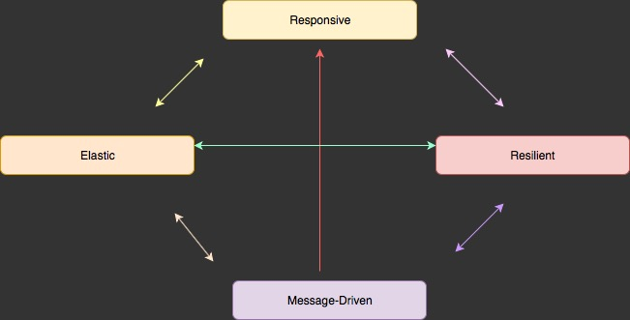
4 Reactive Principles
Notes:
Messages Async Streams

Slide 9
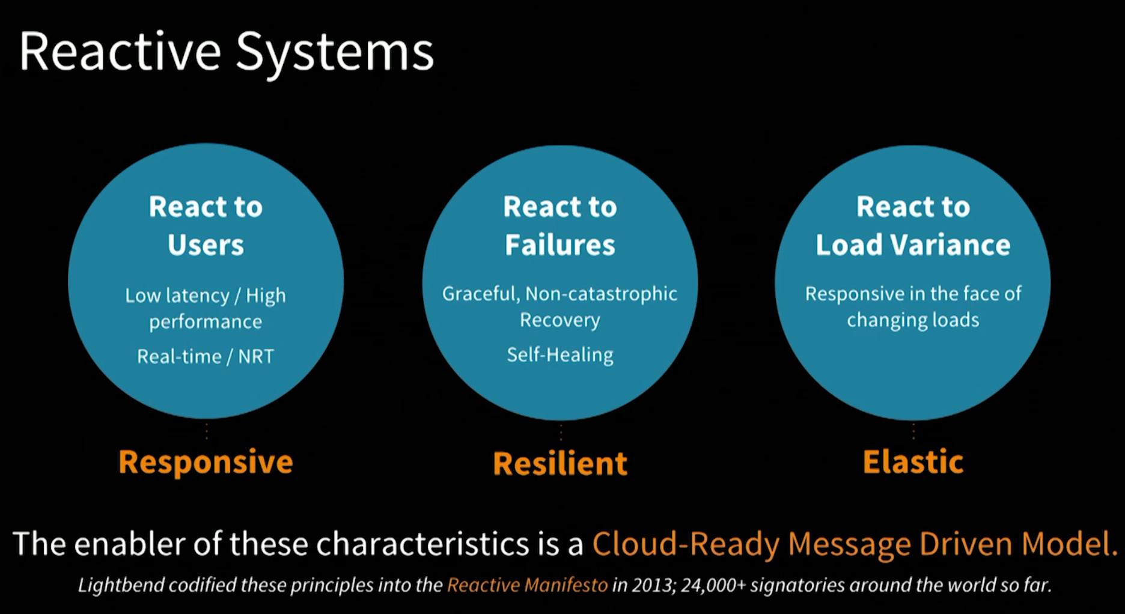
Let It Crash
Message Flow
Notes:
React to Failures
Isolation - bulkheads
Fault Tolerance – Isolation
Supervisory Tree
Expect failure in in distributed systems

Slide 10
Reactive Alternatives
RSocket
Vert.x
Pivotal - Reactor
Reactive Spring
RxJava
Extension- Android

Slide 11
Actors
Notes:
Model of Computation

Slide 12
What is an actor? – Carl Hewitt 1977
Compute
Storarge
Communicate
Universal Primitive of concurrent digital computation
Notes:
Comminicate via Messages
Concurrently
Out of order
At Most Once ( i.e. may not be delivered – network failure or receiver down )
At Least Once ( i.e. receiver may need to deal with duplication )
Exactly once - impossilbe

Slide 13
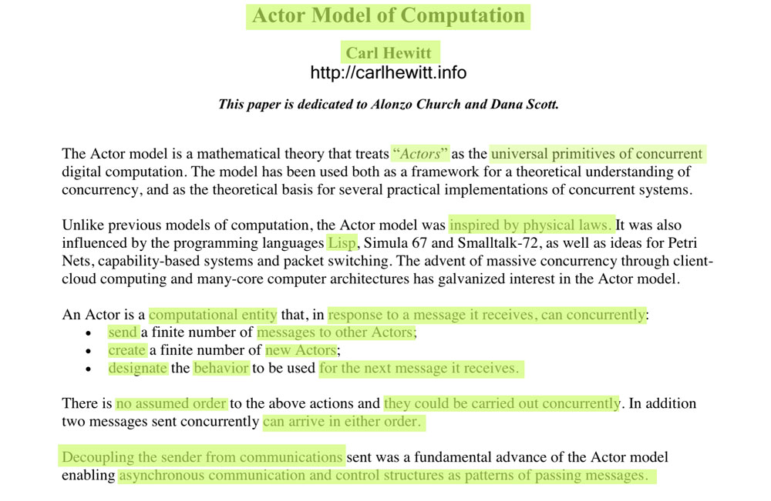
Actor Model Origins - 1977
Notes:
https://arxiv.org/ftp/arxiv/papers/1008/1008.1459.pdf
https://en.wikipedia.org/wiki/Lambda_calculus
Alonzo Church created lambda calculus
- 1930 influenced LISP programming lang and functional programming

Slide 14
OBJECT ORIENTED
ACTORS
Everything Object
Message passing
Synchronous
Blocking
Calls Typically in one Process/ 1-n Threads
Everything Actor
Message Passing
Aynchronous
Non-Blocking
Calls in local or remote Actor systems via network

Slide 15
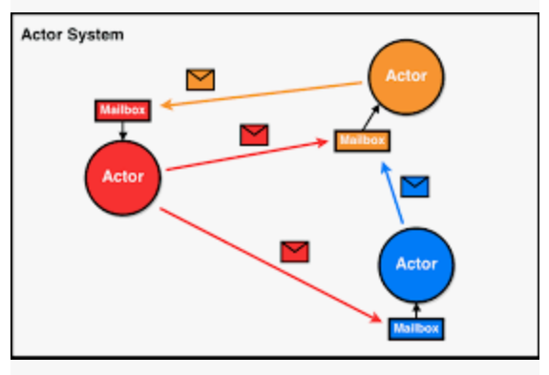
Actor System / Ecosystem
Notes:
1 ant is no Actor
Inbox Queue
Sequential processing in an individual actor
Specialized Q’s
Prioriy
Message types only
1 only till done

Slide 16
In Receiving a message to it’s mail box: 3 OPTIONS:
Create another 1-n new actors
Send messages to other actors
Designate what to do with the message ( can change it’s behavior ) → mutate
Notes:
In response to a message that it receives, an actor can:
make local decisions
create more actors
send more messages
determine how to respond to the next message received.

Slide 17
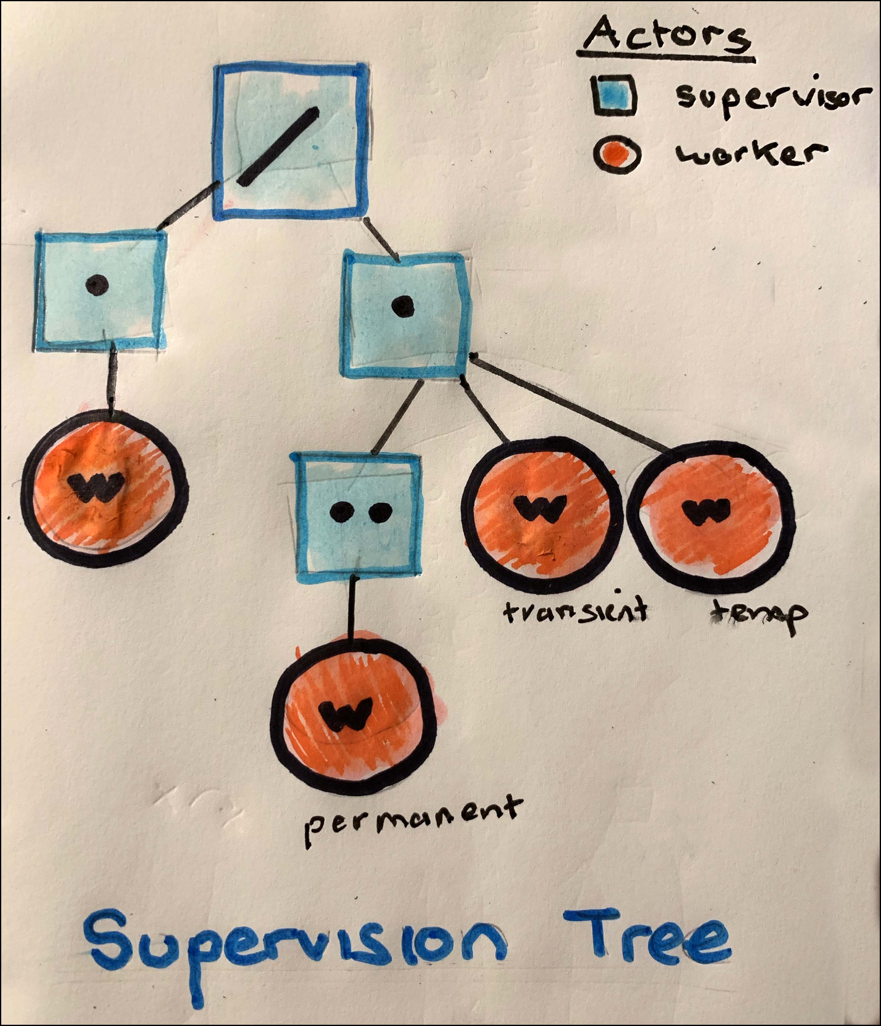
Supervisor actions:
Stop
Start
Restart
TERM/Kill
Message Flow
Supervised
Each child worker actor can be one of three types:
permanent - is always restarted when it dies
transient - is restarted if it dies abnormally
temporary is never restarted.
Notes:
The model (Erlang) is based on the idea of workers, supervisors, and a supervision tree. ... A supervisor can restart a worker if something goes wrong. The supervision tree is a hierarchical arrangement of an application into workers and supervisors.
Each child can be one of three types:
a permanent child is always restarted when it dies
a transient child is restarted if it dies abnormally
a temporary child is never restarted.

Slide 18
Business Logic Separated from Exception/Error Handline logic
Actors / Lightweight v.s. Threading
Distributed/Local v.s. Single Process Single Machine
Notes:
Not silver bullet
Still cases for threads – Office Apps / Photoshop iTunes etc

Slide 19
Actor based frameworks
Actor Model Proposal 1977
Erlang 1982
Scala 2001
Akka 2009(beta) – 2019(stable)
Microsoft – Orleans 2018? 5961 github commits
…
Notes:
Time line
Orleans - Distributed Virtual Actor Model http://dotnet.github.io/orleans

Slide 20
Akka
Notes:
Lightbend open source
Scala Martin Odersky
Akka
Lagom – opinionated – may be easier to build Microservice(system)

Slide 21


Distributed Actor System
building fault tolerant transaction processing
applications
resilient
elastic
distributed
real-time
Notes:
Lightbend open source and commercial products – IBM alliance partner
Scala - Martin Odersky
Akka
Lagom – opinionated – may be easier to build Microservice(system
Customers
Paypal 1 Billion Tx/Day
Verison

Slide 22
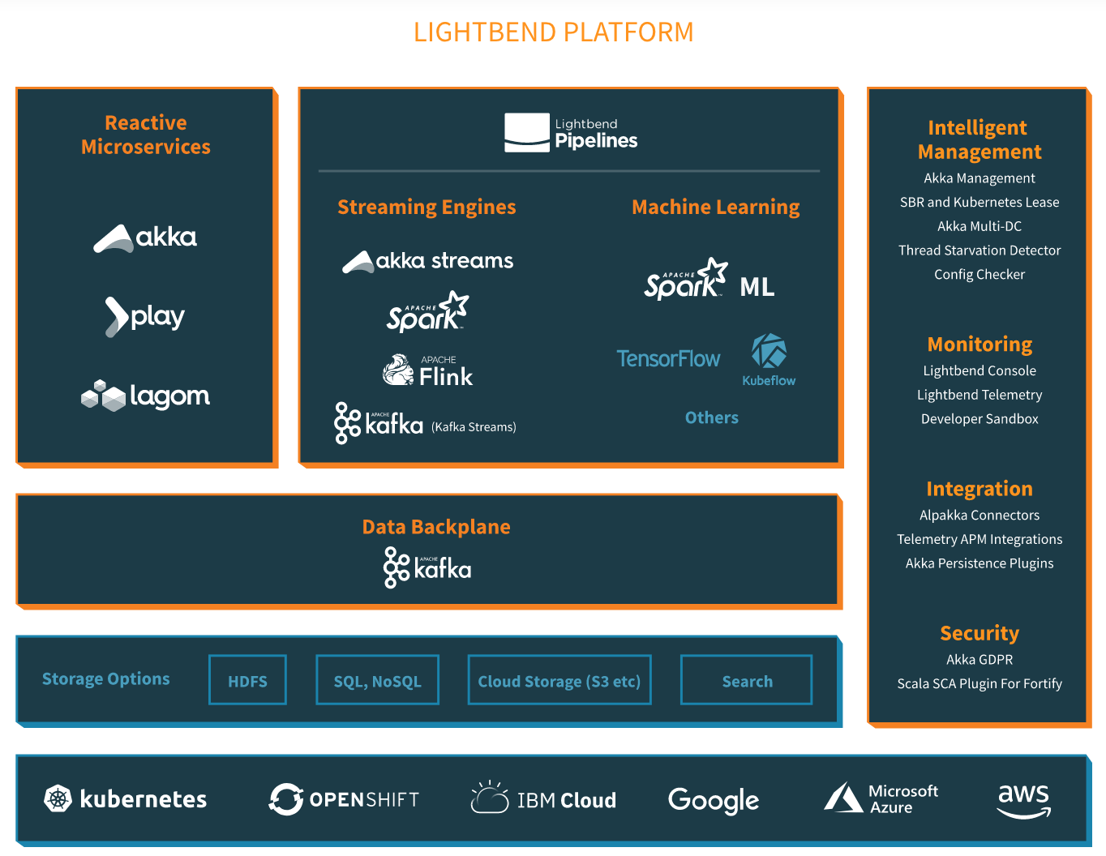

Slide 23
Akka – distributed Actor System – async messaging
A
A’
Send()
Received()
Notes:
Comminicate via Messages
Concurrently
Out of order
At Most Once ( i.e. may not be delivered – network failure or receiver down )
At Least Once ( i.e. receiver may need to deal with duplication )
Exactly once - impossilbe

Slide 24
Akka – Messaging Protocols
AKKA:TCP
AKKA: (UDP)

Slide 25
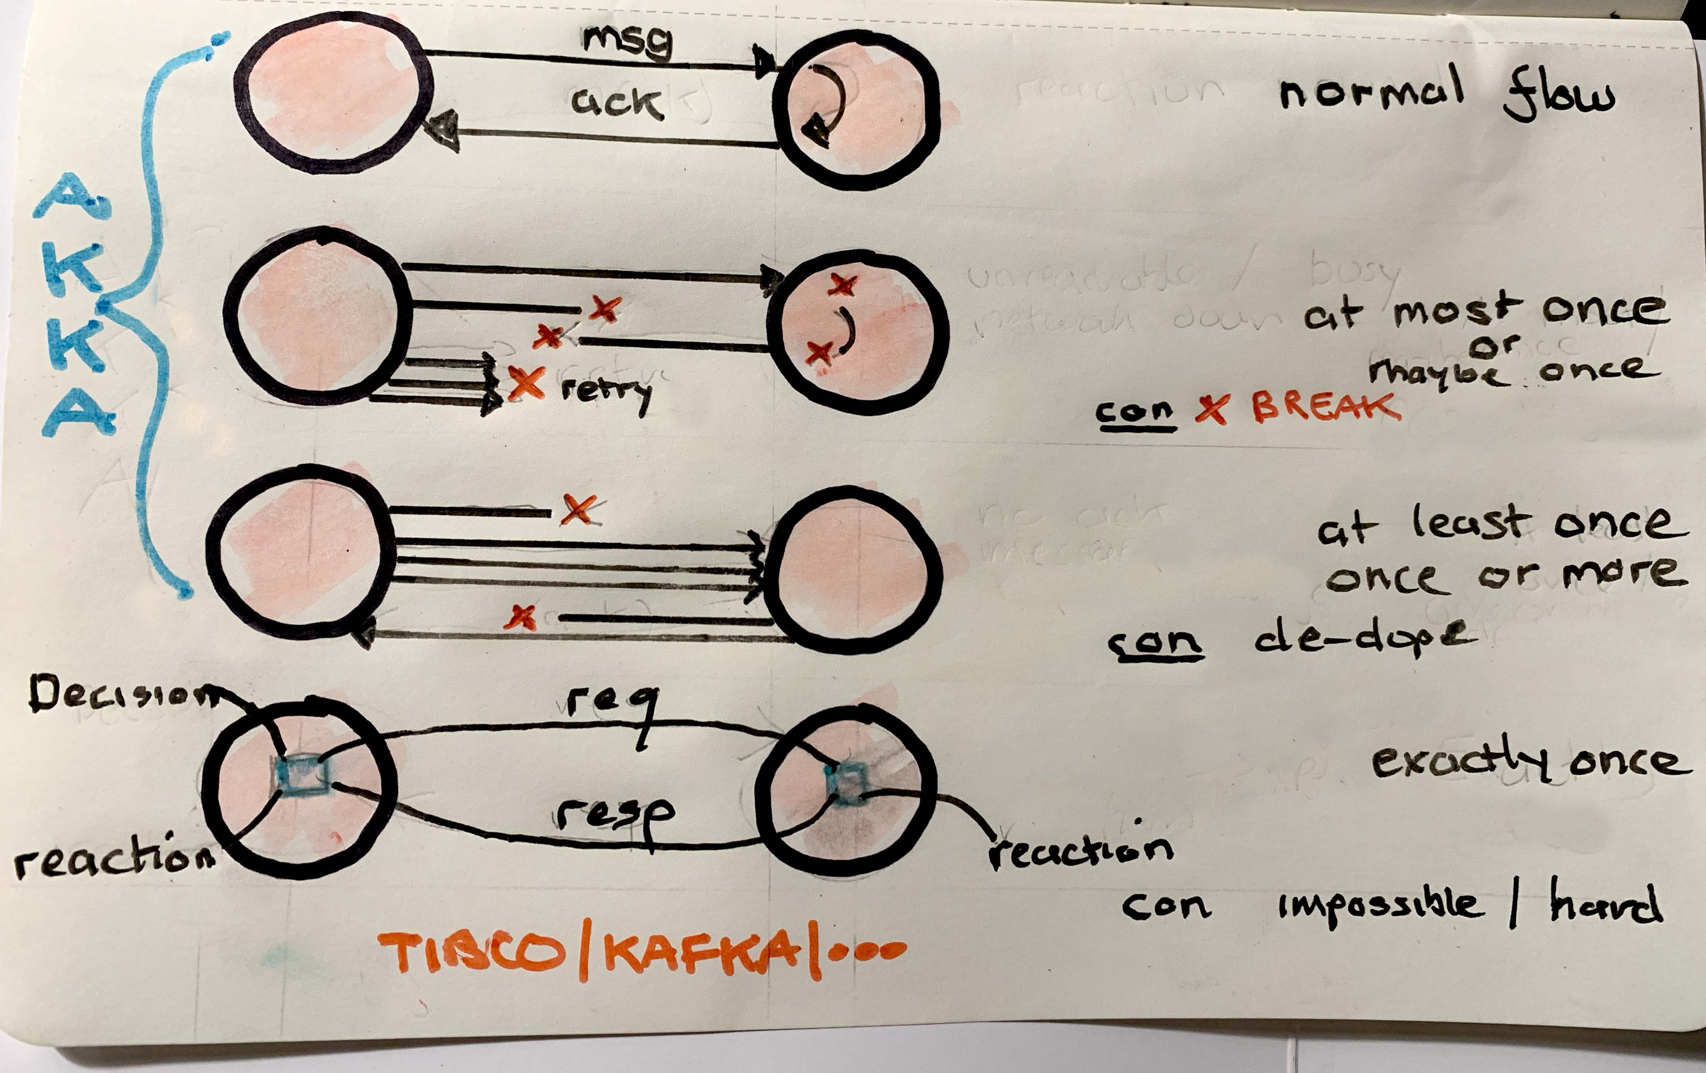

Slide 26
Demo simple hello world Actor

Slide 27
Akka – Message types
Regular
Specialized
Manage actors
Broadcast
PoisonPill
Kill

Slide 28
Akka – 5 Routing Strategies
Scatter Gather First Complete
Consistent Hashing Pool
Distributed Pub/Sub
Dynamic Pool
Scale out / horizontally – Remote

Slide 29
Akka - Scatter Gather First Complete
Get 1st Response from from First actor that
Completes it’s action
Ignore the subsequent replies

Slide 30
Akka - Consistent Hashing Pool
Cache
One Actor sends messages to the SAME Actor

Slide 31
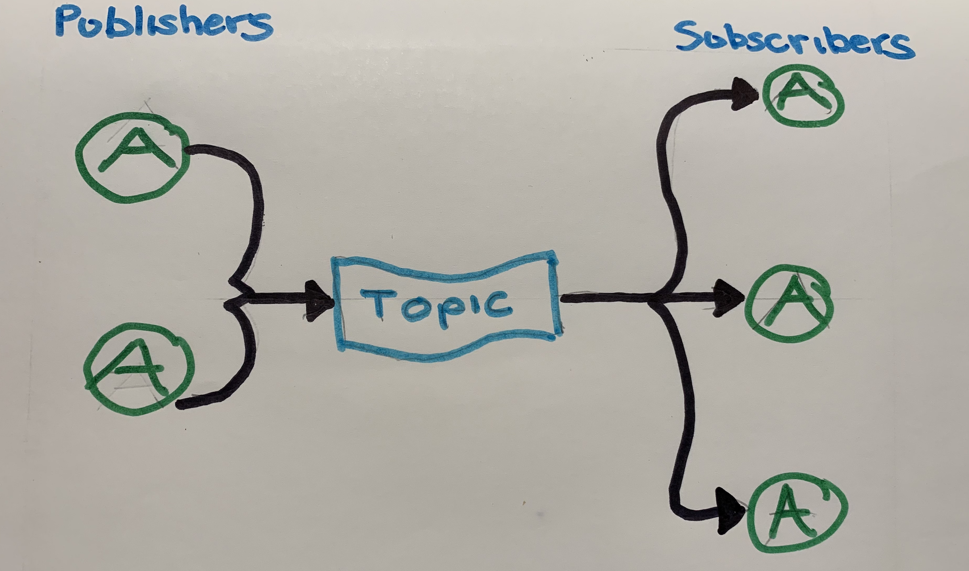
Akka Cluster - Distributed Publish/Subscribe
Notes:
All subscriber Actors get the same message

Slide 32
Akka - Scale out/horizontally – Remote
Actor creates remote Actors remotely
To scale - ELASTICITY

Slide 33
Akka - Dynamic Pool
Elastic
Adjusts depending on required load / # requests

Slide 34
Akka - Distributed
Remoting
Clustering

Slide 35
Remote
Clustering
Location Known
Peer to Peer
Akka:tcp://<<actor>>@34.56.55.202:7676
Lookup vai Actor Selection by traversing Actor Hierarchical
Tree
No Need for Address just UID/Name
Distributed Cluster of different JVMs ( on K8s/OS pods)
Akka:tcp//LookingUpRemoteActors@localhost:2553/user/RemoteActorName
Logical Member of a cluster
Notes:
v.s.
- Location Transparancy
Transparent if Actor is local or remote

Slide 36
AkkaCluster – New Terminology
Node
Cluster
Leader
Seed
Failure Detector
Role
Gossip protocol

Slide 37
Leader Actor (singleton)
Responsible for Node Membership
State Changes

Slide 38
Seed Actors
An Actor that is used by other actors to Join
Cluster

Slide 39
Failure Detector
System component of Actor Cluster System
Auto detects UNREACHABLE Actors
Uses the Phi Accural Failure Algorithm to Detect downed or missing actors

Slide 40
Roles
0 .. N
Gives actors -> responsibility(ies)

Slide 41
Unreachable – system componet
Node that accounts for network failure
Can
Down Actors
Remove Actors
Notes:
‘Garbage collection’

Slide 42
Lifecycle -5 states
Join
Up – regular operating state
Leave/Exit – removal process
Down – Actor Node no longer part Cluster decision making processes
Removed – Actor Node no longer a MemberOf acluster

Slide 43
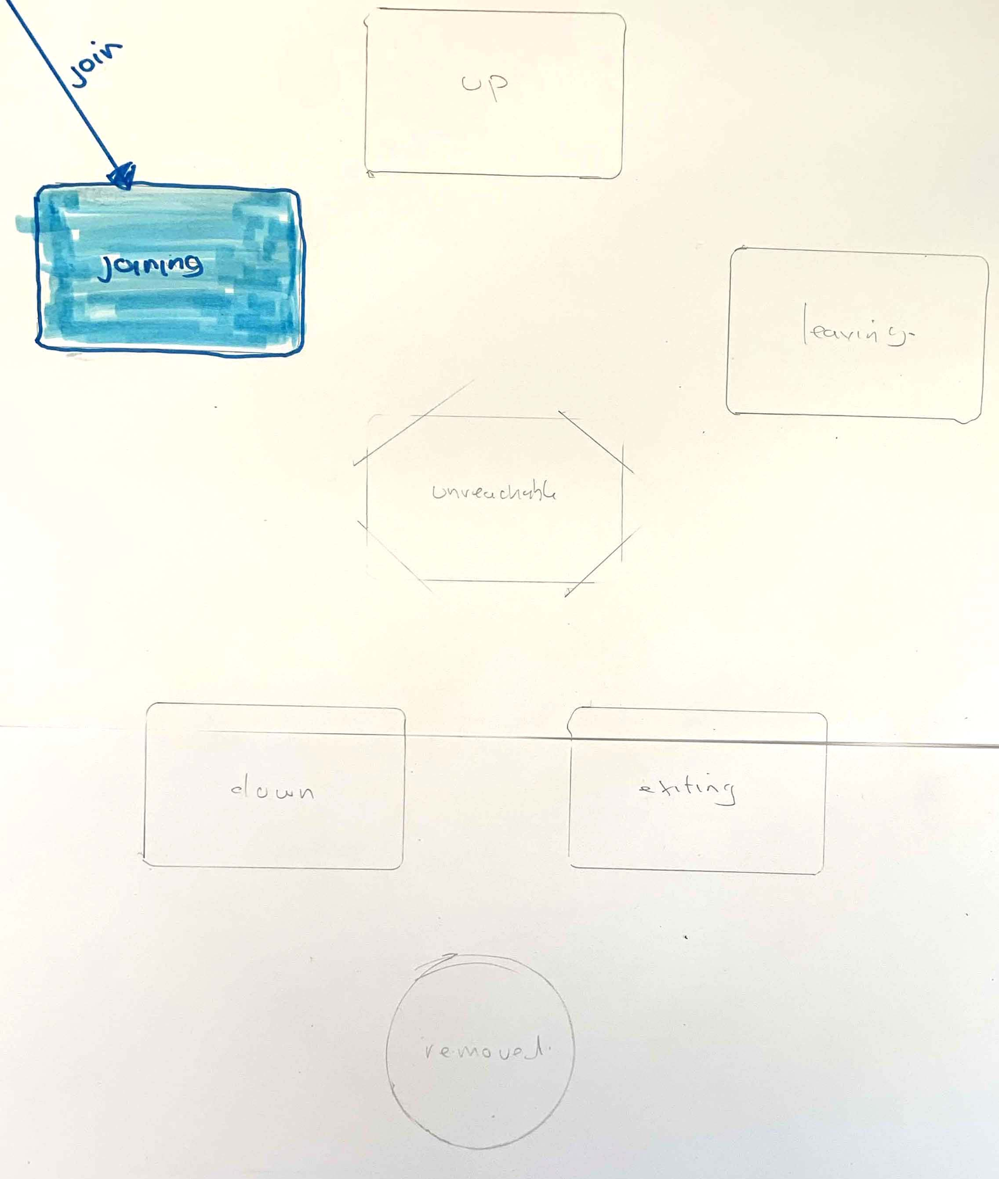
key
L.A. Leader Action
(fd) Fault Detection
Node States in an Akka Cluster
IBM Developer Advocacy

Slide 44
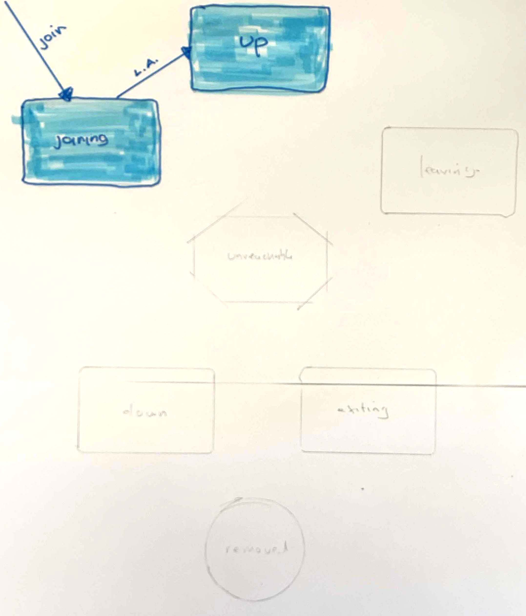
key
L.A. Leader Action
(fd) Fault Detection
Node States in an Akka Cluster
IBM Developer Advocacy

Slide 45
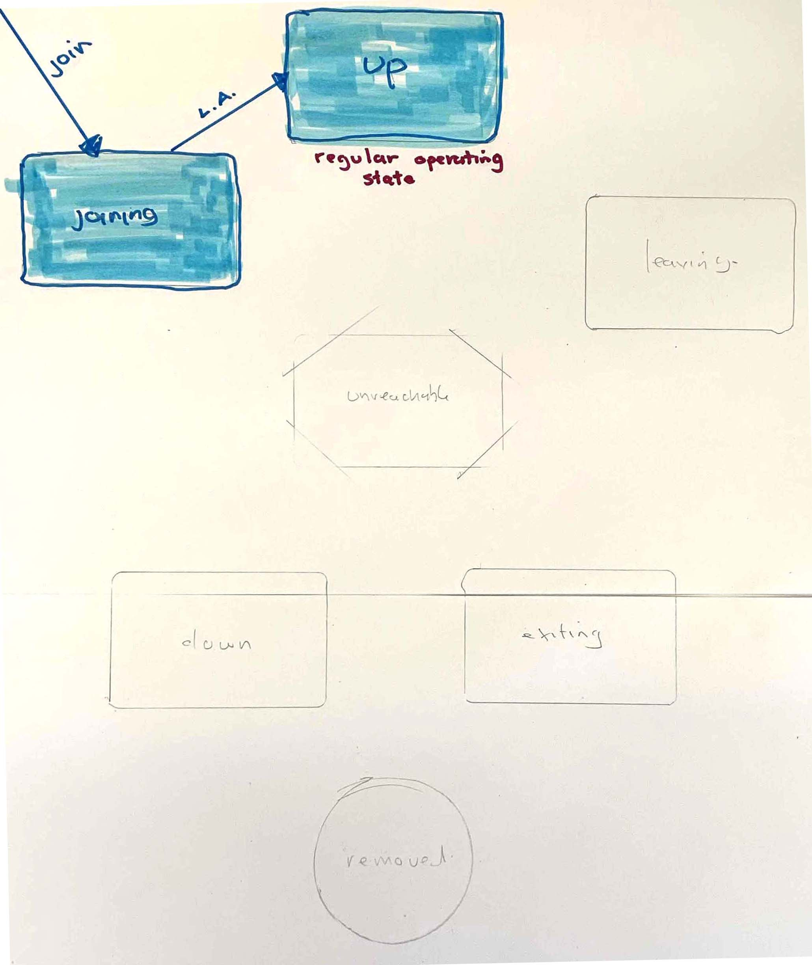
key
L.A. Leader Action
(fd) Fault Detection
Node States in an Akka Cluster
IBM Developer Advocacy

Slide 46
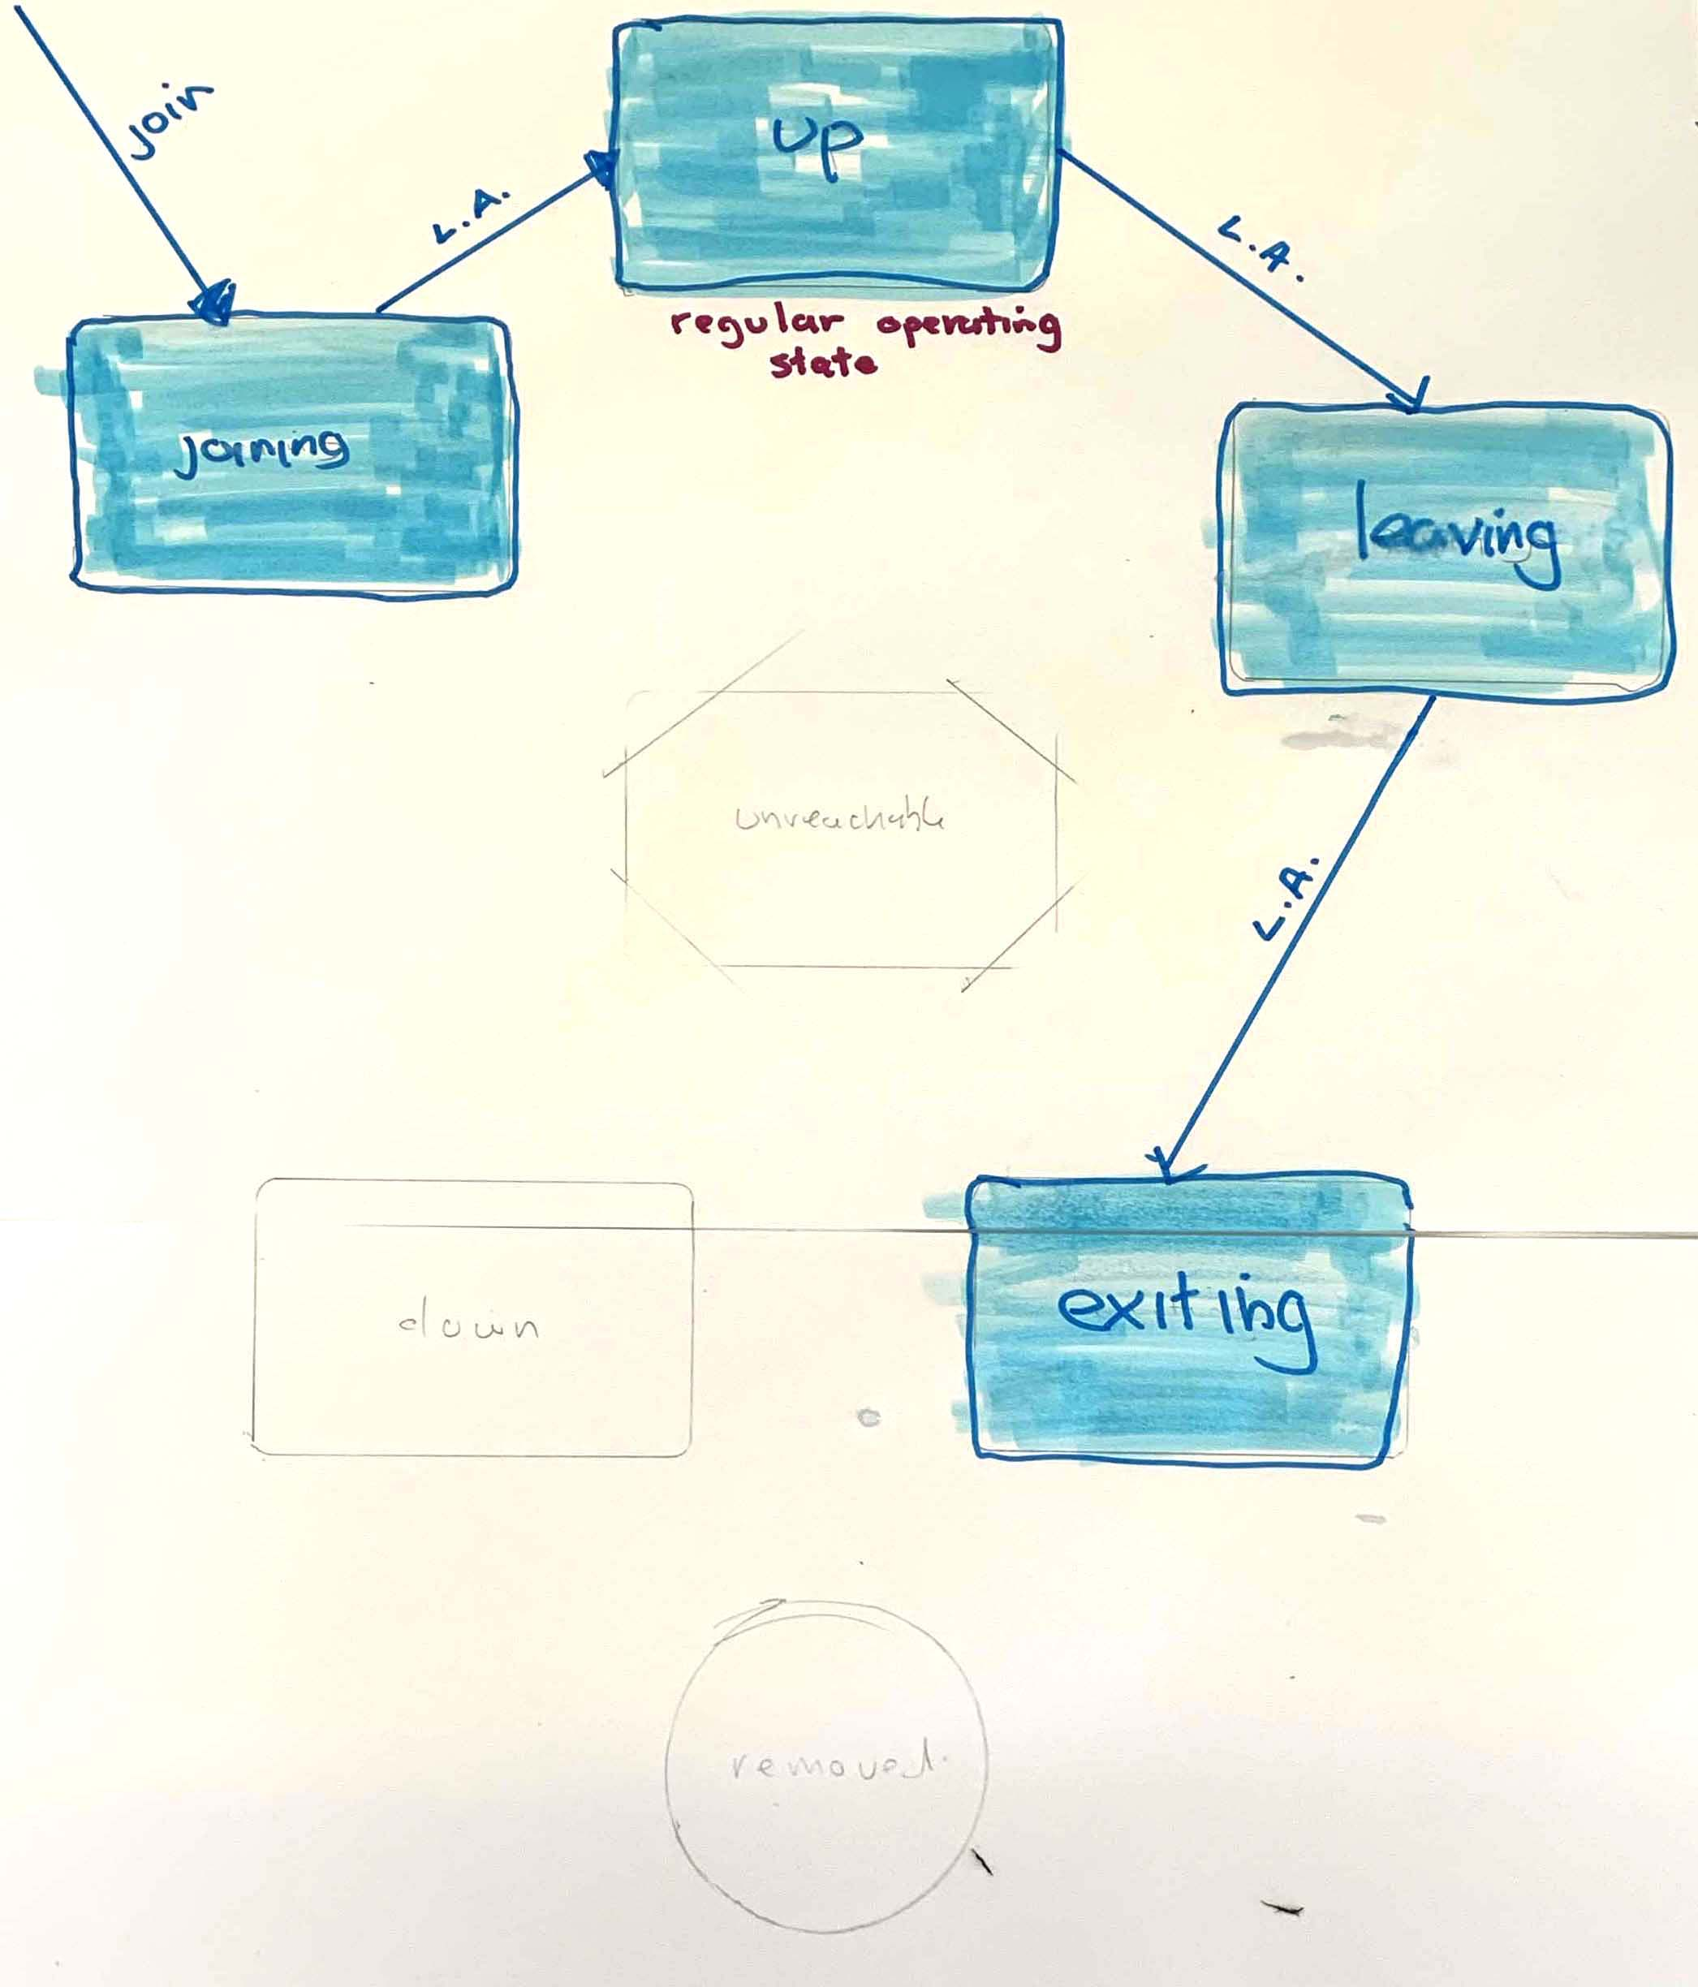
key
L.A. Leader Action
(fd) Fault Detection
Node States in an Akka Cluster
IBM Developer Advocacy

Slide 47
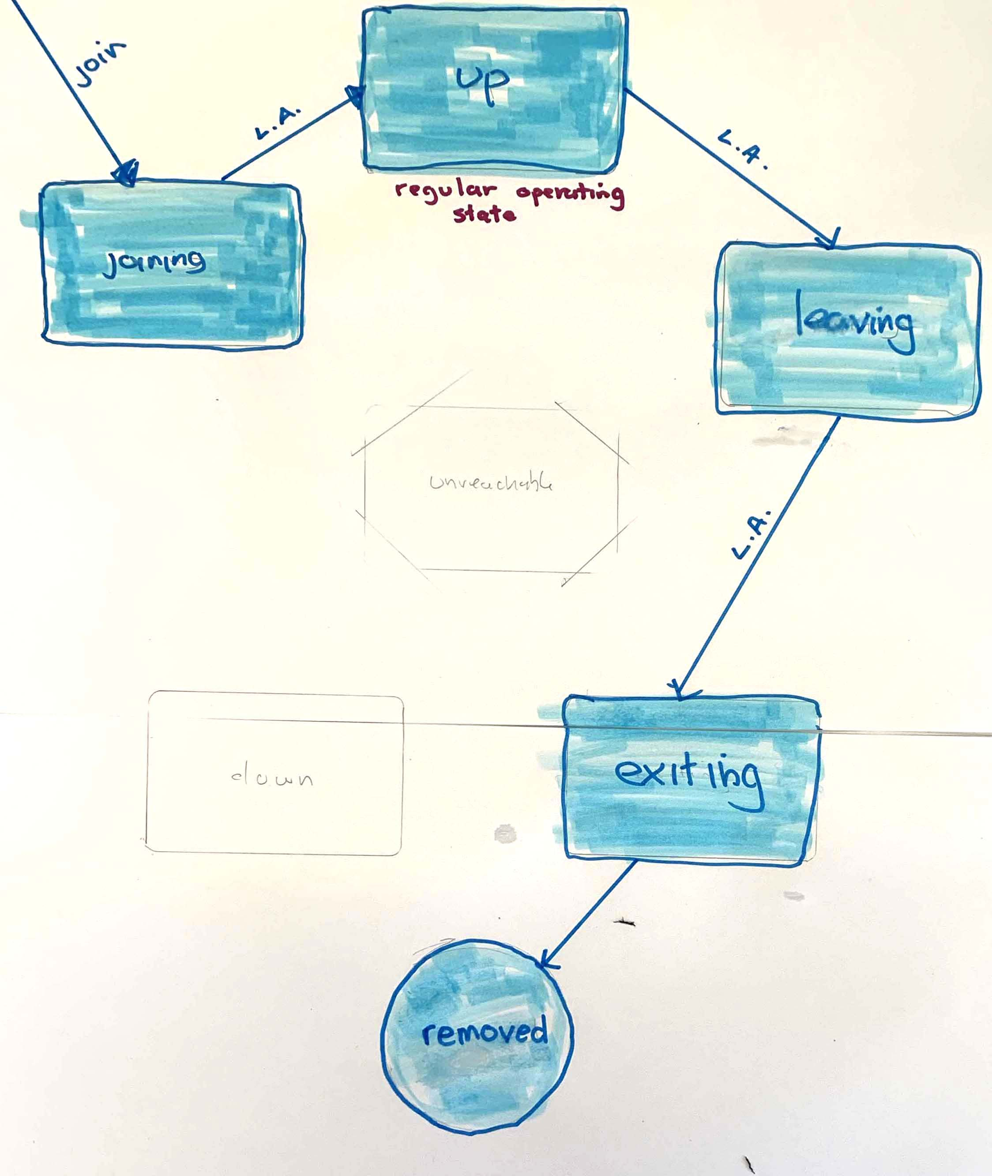
key
L.A. Leader Action
(fd) Fault Detection
Node States in an Akka Cluster
IBM Developer Advocacy

Slide 48
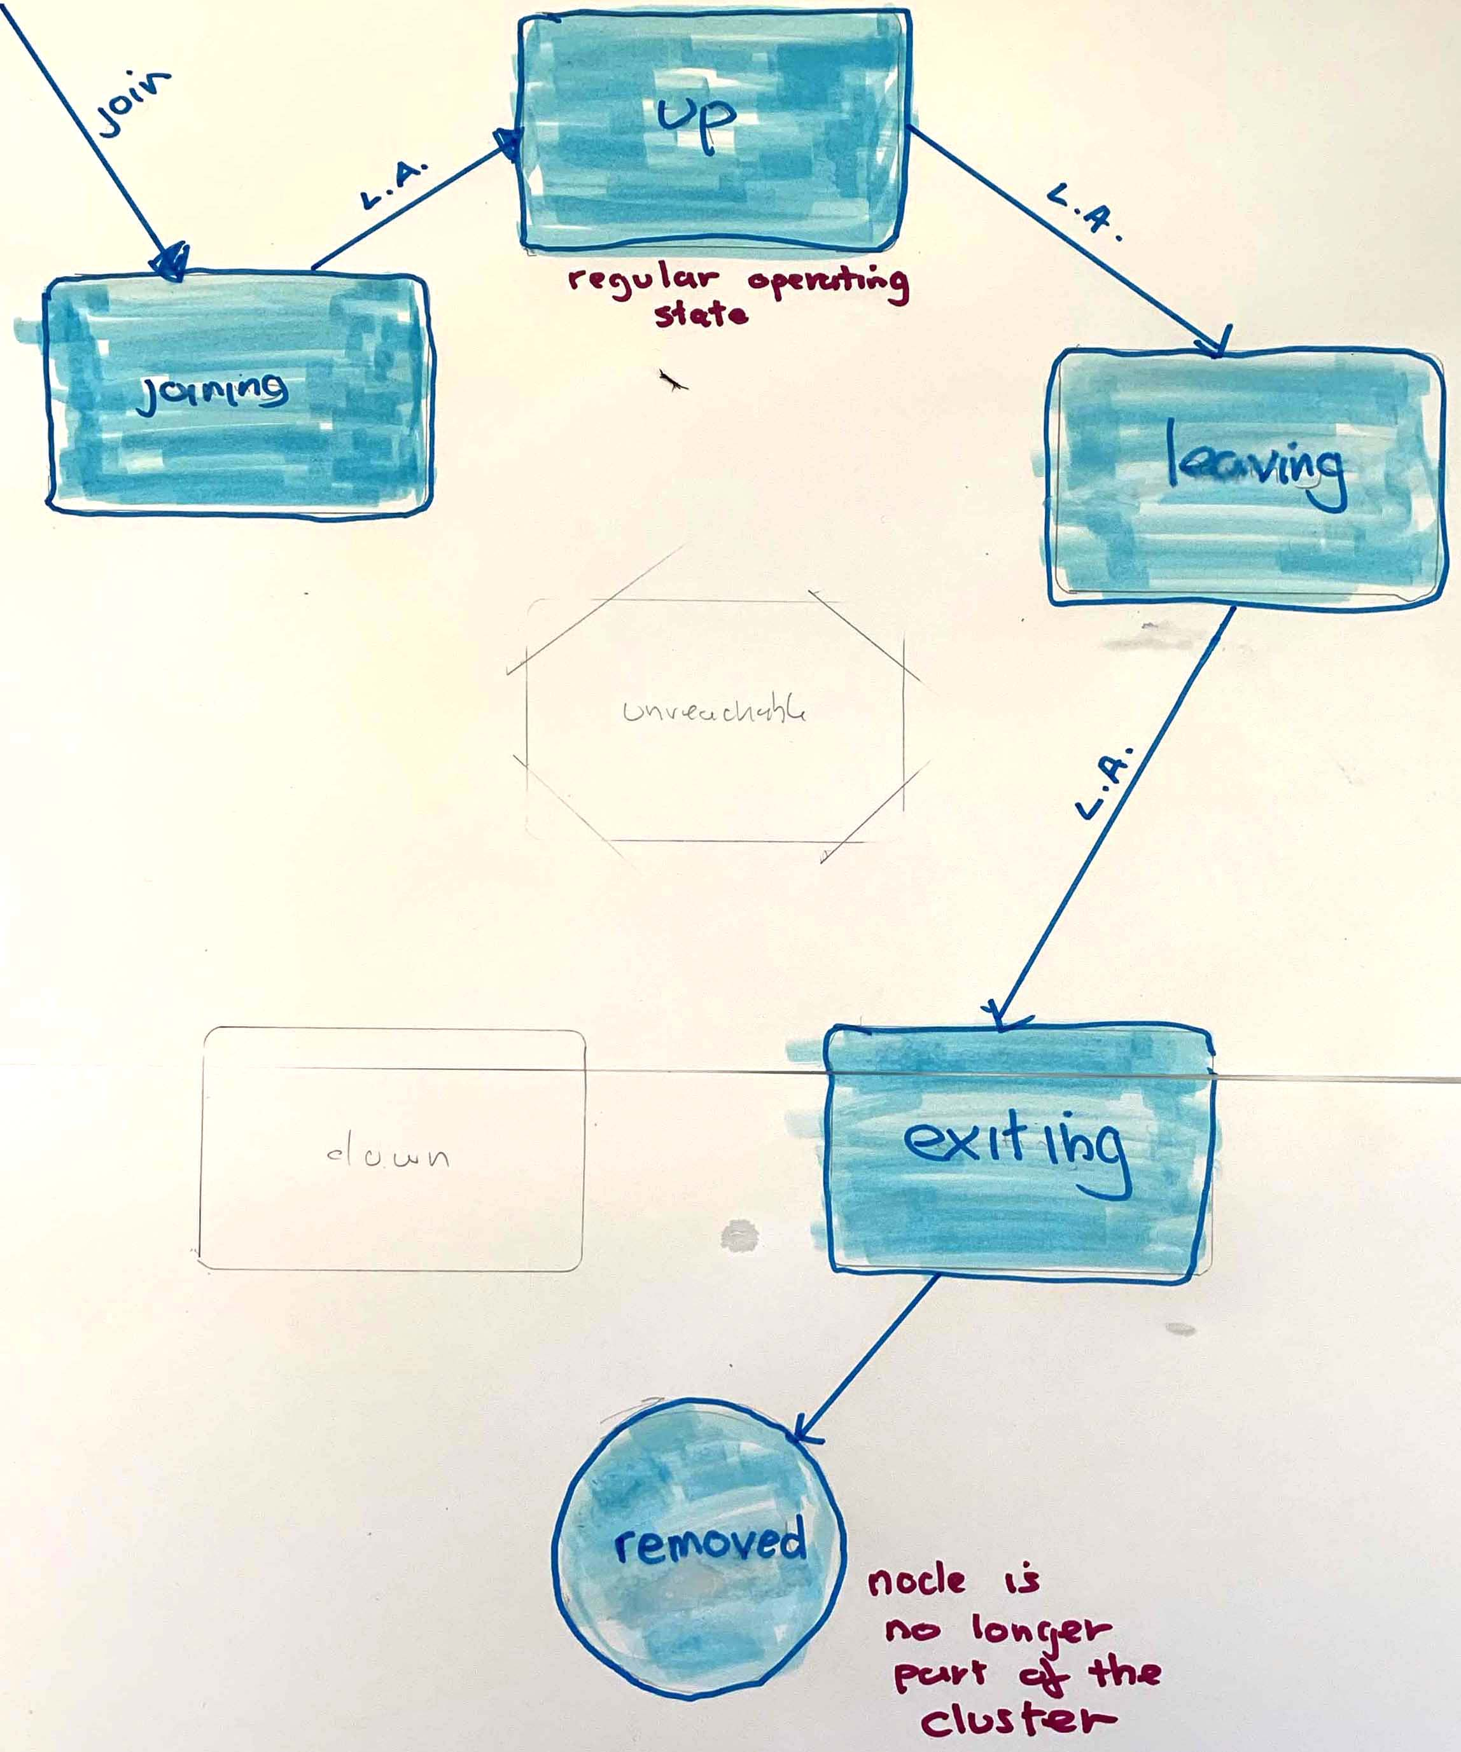
key
L.A. Leader Action
(fd) Fault Detection
Node States in an Akka Cluster
IBM Developer Advocacy

Slide 49
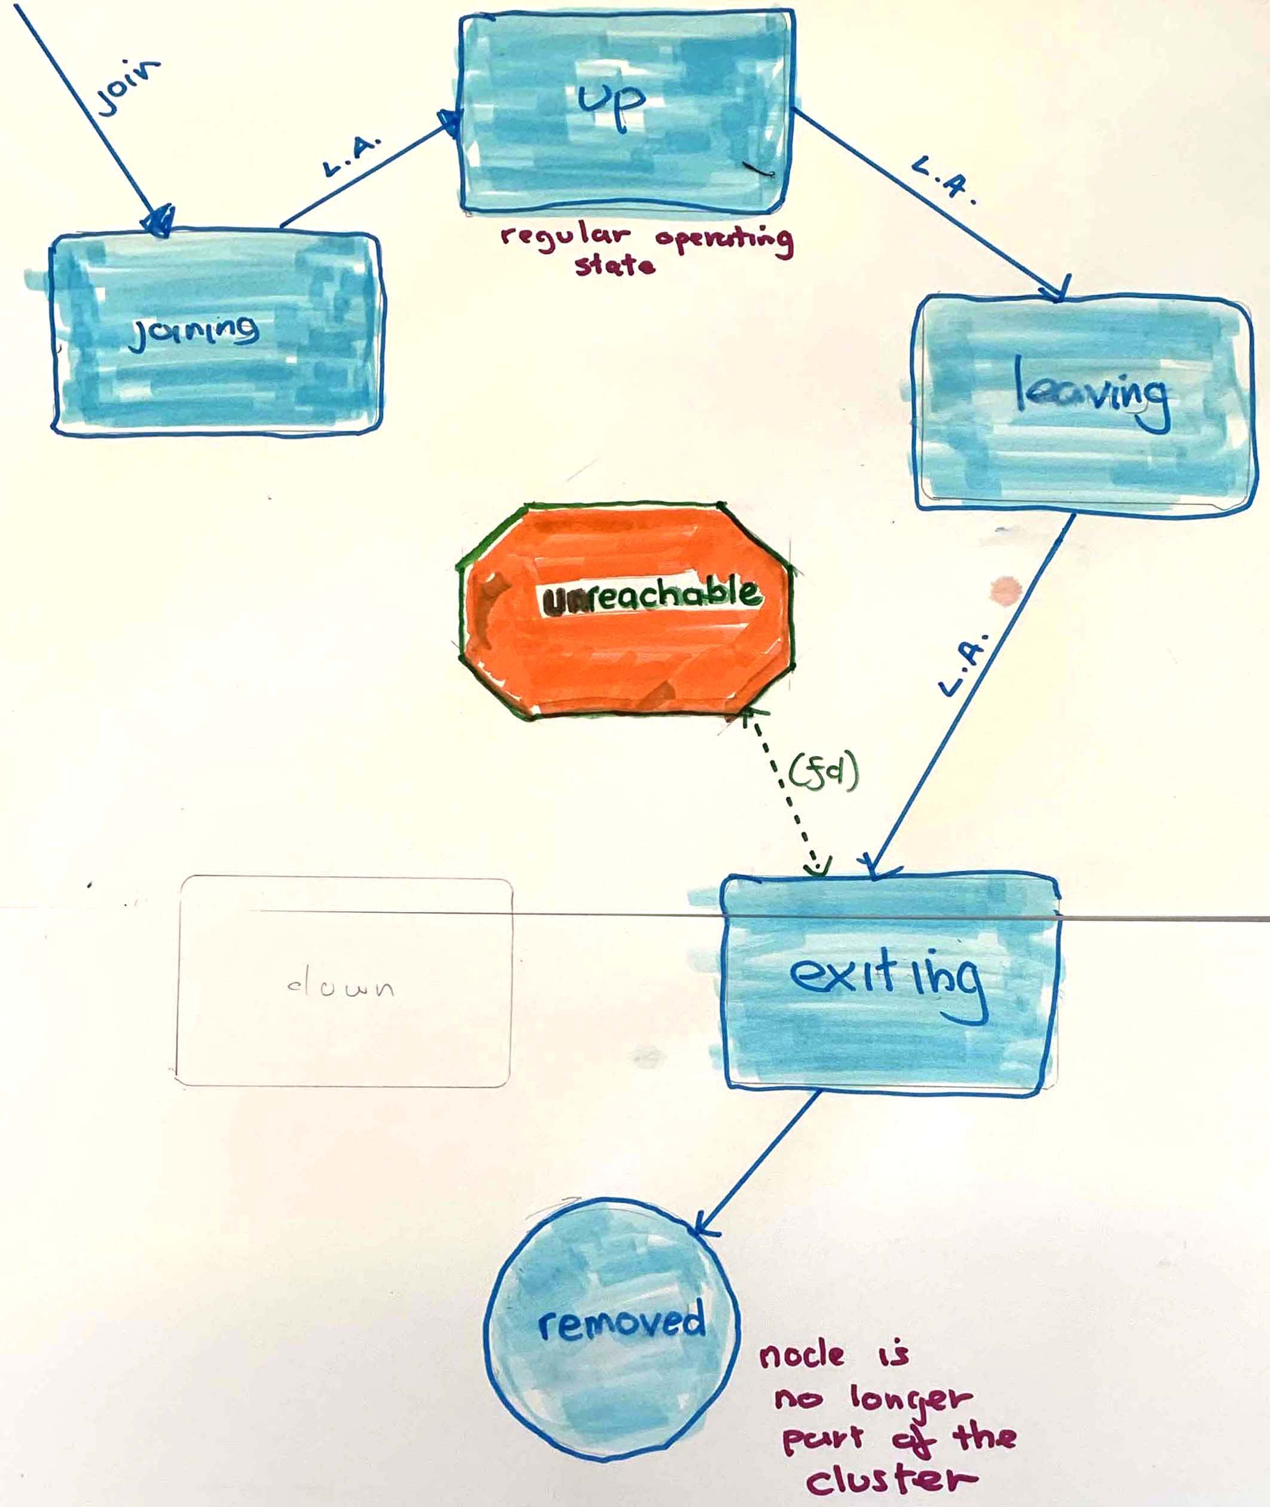
key
L.A. Leader Action
(fd) Fault Detection
Node States in an Akka Cluster
IBM Developer Advocacy

Slide 50
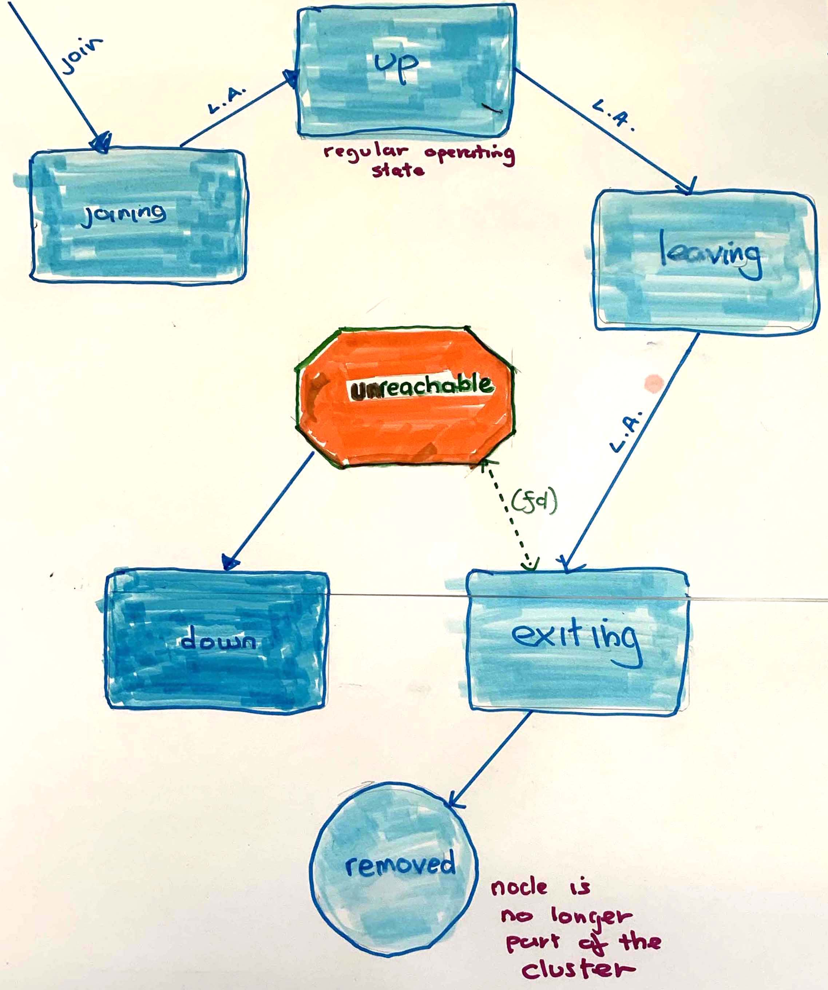
key
L.A. Leader Action
(fd) Fault Detection
Node States in an Akka Cluster
IBM Developer Advocacy

Slide 51
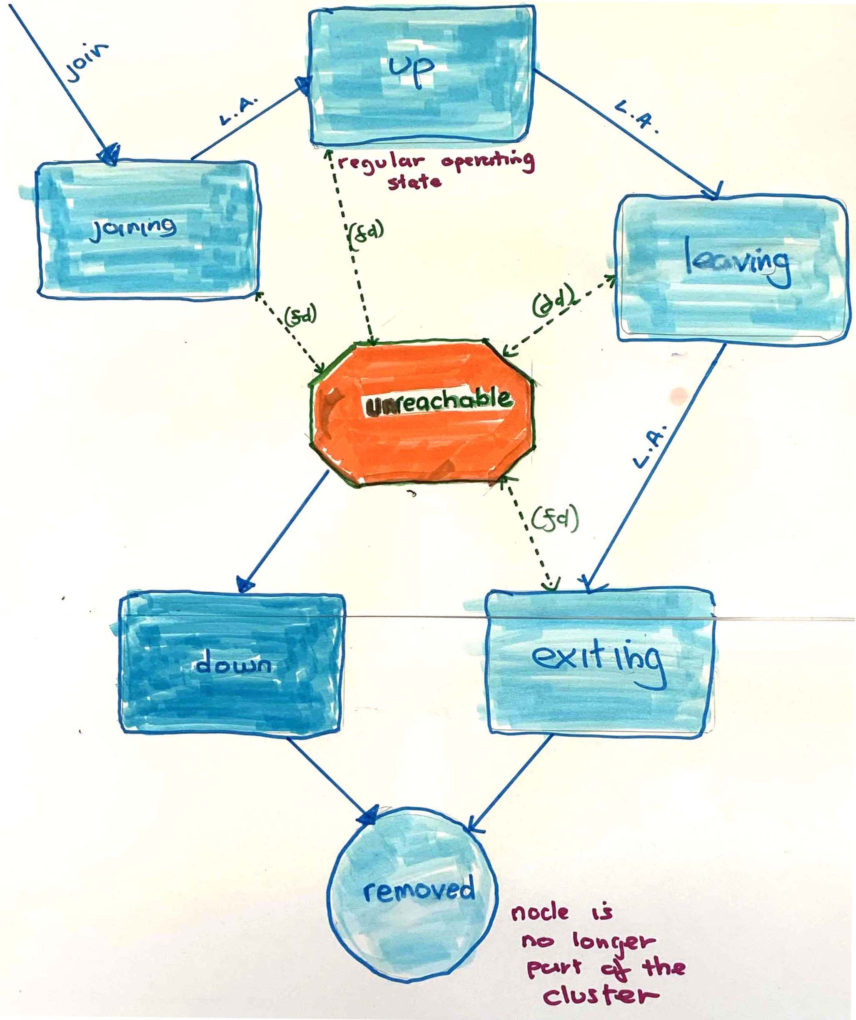
key
L.A. Leader Action
(fd) Fault Detection
Node States in an Akka Cluster
IBM Developer Advocacy

Slide 52
Akka – Ecosystem Tools
Sharding
HTTP
Data Sharing
Kafka Publishing

Slide 53
Sharding
Routing – Location Transparency
Auto dist Node Actors across multiple Clusters/JVM
The Node Actors aka Entity Nodes
Context Change become()
GUID and STATEFUL
Event Log / Sourcing
CQRS
Notes:
Because scale out/horizontally
This is all because of cluster sharding – the essence of Actor systems ARE
SO amazing
☺

Slide 54
HTTP
REST DSL
Regular
Websockets

Slide 55
SHARED DATA
CRDTs
Eventual Consistency
CAP theorem
If Collisions
Resolved with
Monotonic merge function Algorithm
Notes:
Conflict Free Replicated Datasets – google docs sharing
Irony – because we said isolation and state is NOT shared
But in some case we need to share data btween actor

Slide 56
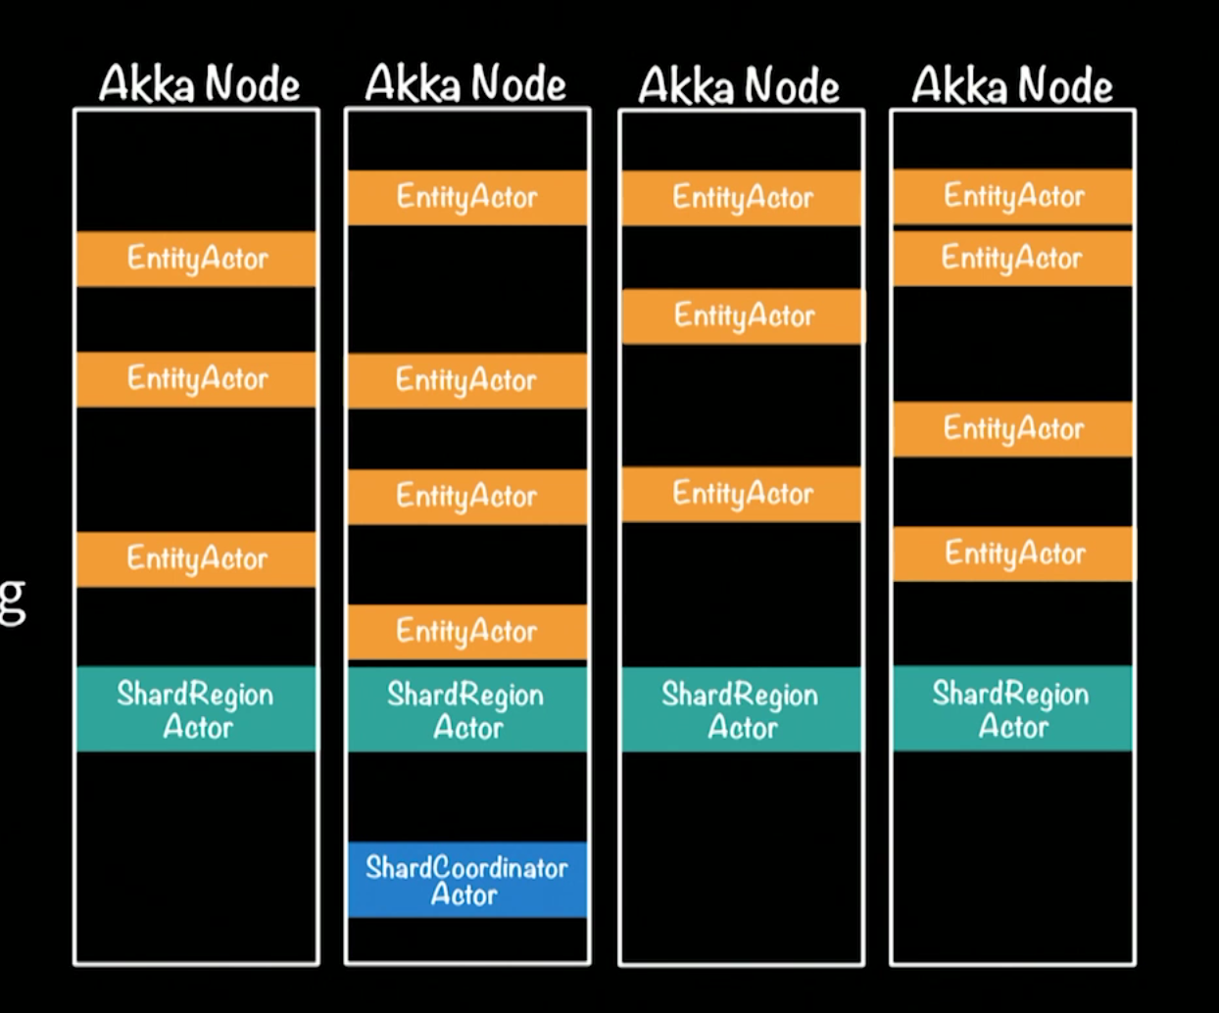
Akka Entity Distributed sharding
Notes:
Moer interesting shard region dist messages to right place in ecosystem
Entity only place where change – actor is the concurrency ‘multi-thrading’ only a single actor ( eg #67 )
Akka persistence – Cassandra etc -
But event log
Write side
Read side

Slide 57
KAFKA - publishing
Publish to Kafka event - topic
Down stream DB processing
Keeps blocking operation
Out of way fast data flow processing
CQRS – Q making materialized views

Slide 58
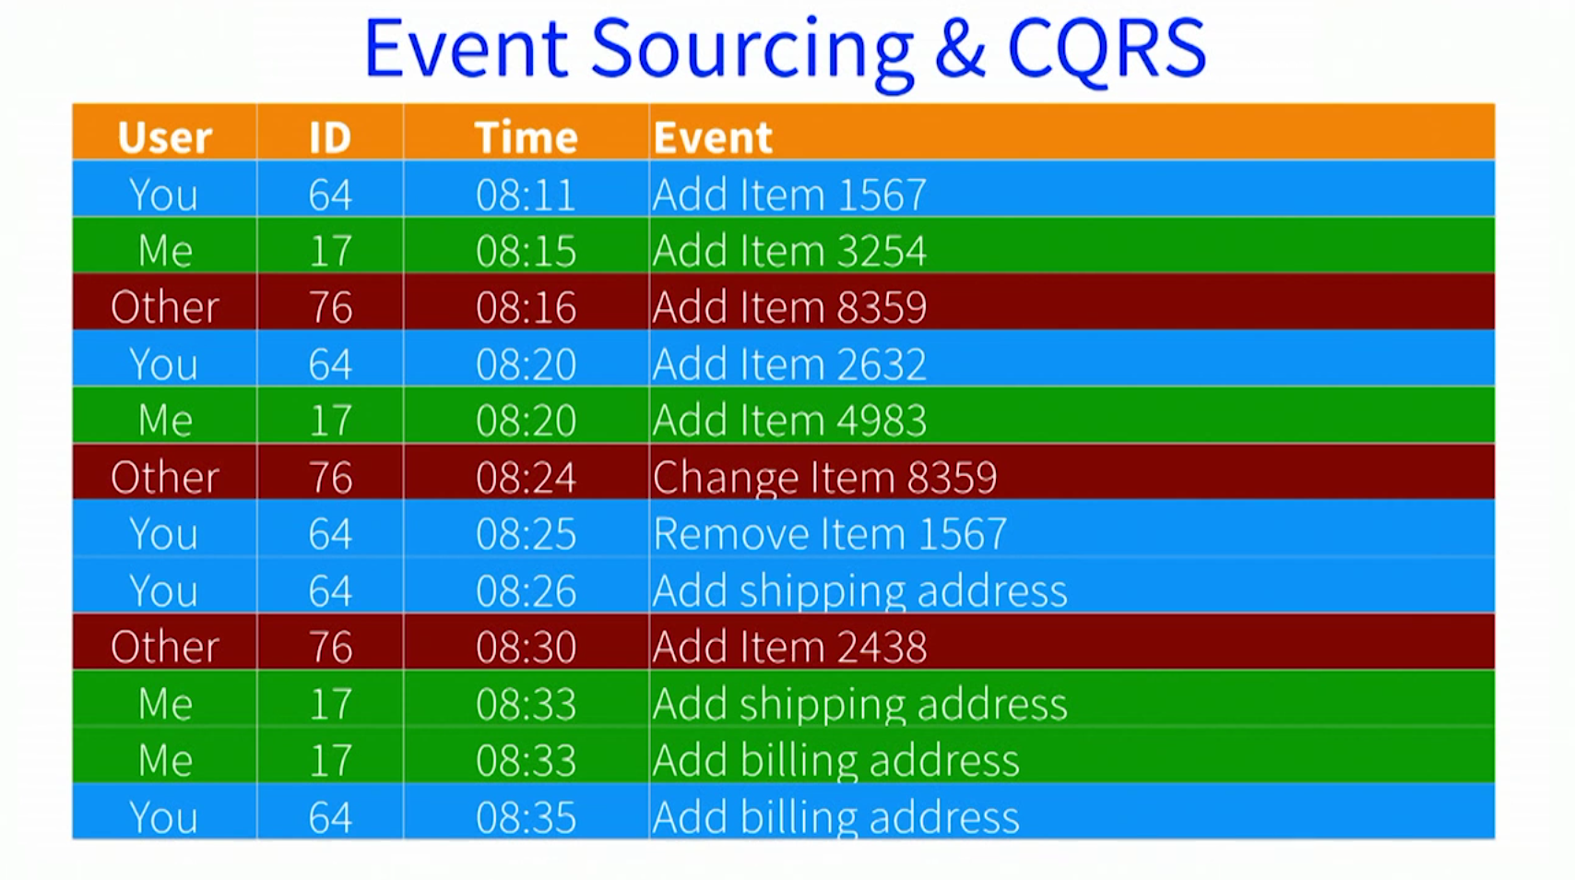
Event sourcing and CQRS
Command Query Responsibility Segregation
Message Flow
Notes:
Used a lot at customers
:
Store events not a db table
To get current state – replay events ( including –ve data like deletes – more interesting to data scheinctists )

Slide 59
Akka – Design Patterns
Master Slave Work Pulling
Ordered Termination
Throttle – circuit breaker
Notes:
Few interesting ones:

Slide 60
Master Slave Work Pulling
master actor control how many slaves can do work
distribute it among them
pushes work tasks to them when they are ready.
Notes:
Worker pattern

Slide 61
Ordered Termination
In Supervisory Tree
Ordered TERM / Kill Actors
Stops children in a DETERMANISTIC way
Reaper Actor can watch as Actor Nodes TERM

Slide 62
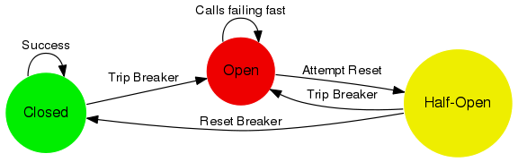
Throttle
Circuit Breaker
Notes:
A circuit breaker is used to provide stability and prevent cascading failures in distributed systems. These should be used in conjunction with judicious timeouts at the interfaces between remote systems to prevent the failure of a single component from bringing down all components.

Slide 63
Akka Cluster Demo https://bit.ly/ 2lSrLza
Notes:
Crop circle
Show viz 1st
OpenShift pod gui console on IBM cloud (vm)
Scale pods up / down
Show pods oc show pods / node
Tail log

Slide 64
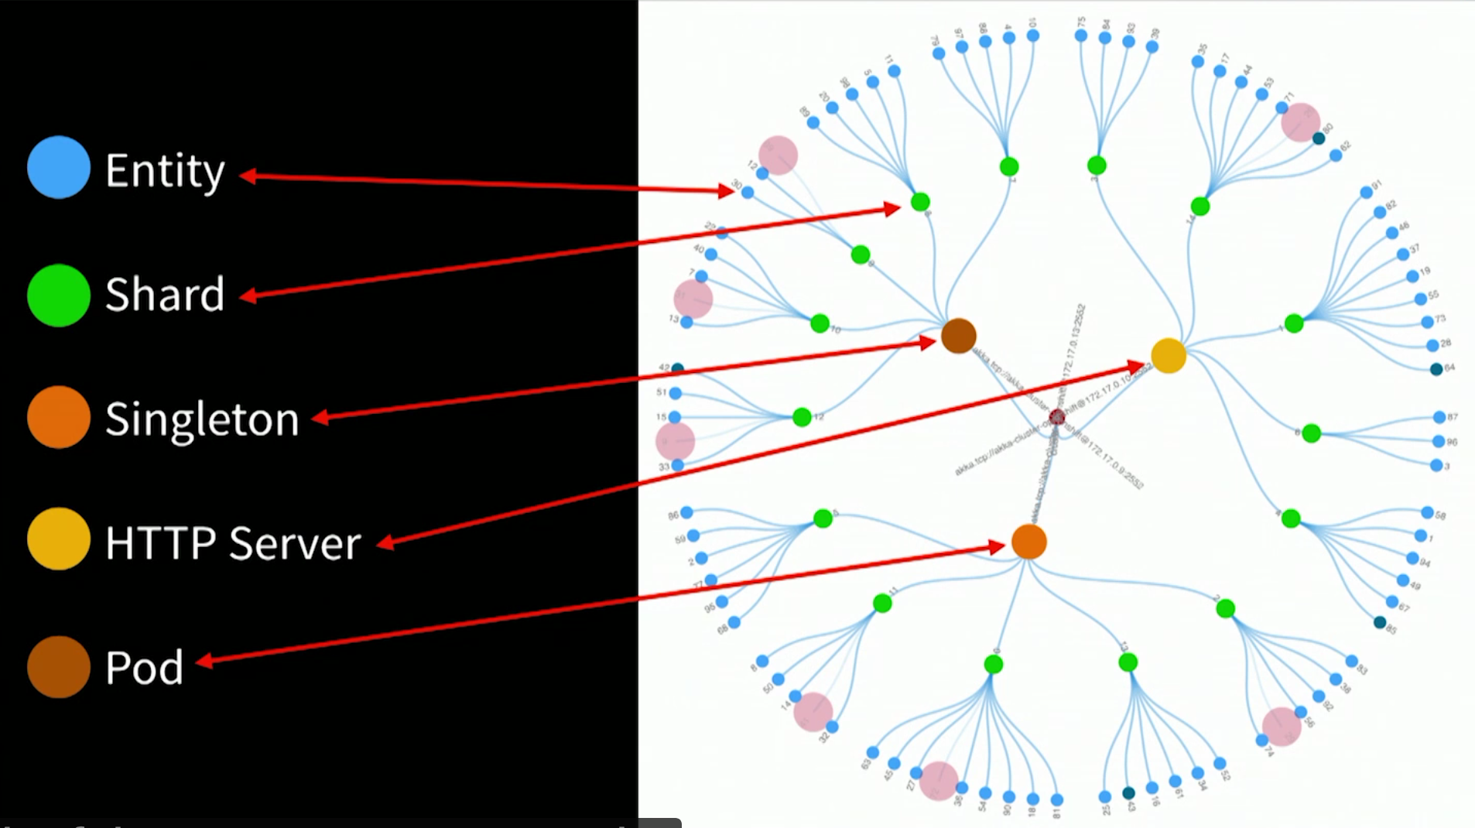
Demo – d3 visualization
Notes:
Microservice out on the perimeter Blue dots
State – banck occont or shopping cart or IoT device

Slide 65
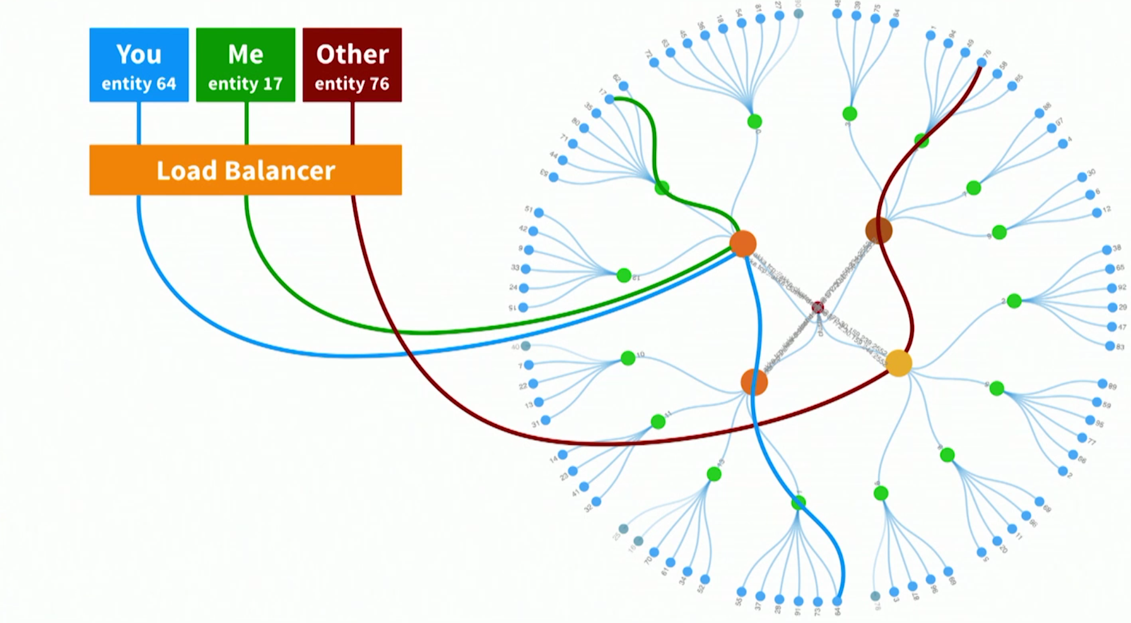
Cluster entity actors
Message Flow
Notes:
Client doing stuff on specific entity
Client does something on entity 64
Quick lookup – is this in this jVM – in other JVm request fwd
Blue line what shard
Is this mine
Is actor is alive
If yes fwd
If not creates actor – recovers state from DB –
Or most likely from
Event sourcing or CQRS

Slide 66
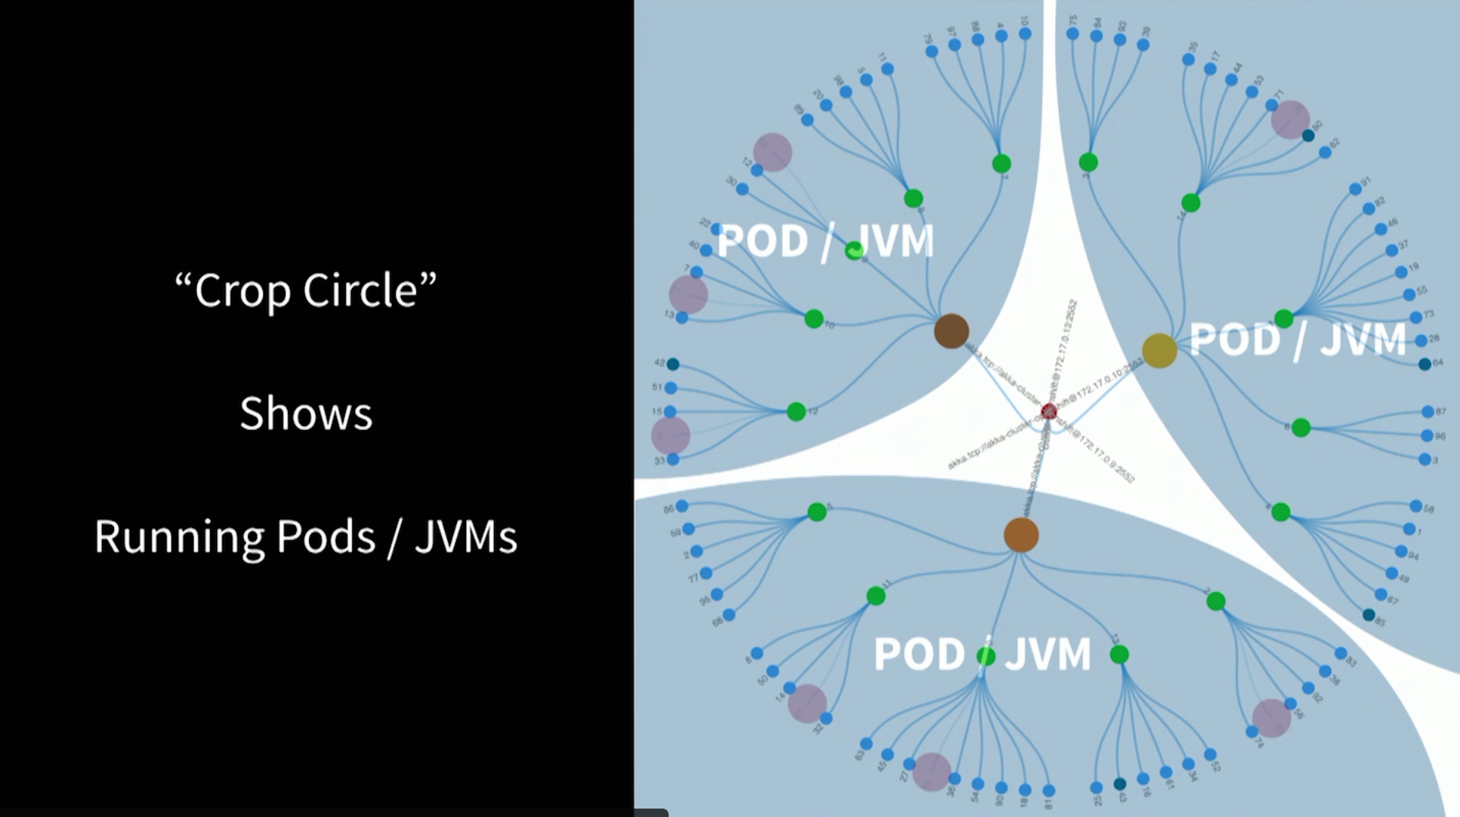
Demo – d3 visualization
Each OpenShift Pod runs a single JVM

Slide 67
Dev -> Deploy strategies
Notes:
Crop circle
Show viz 1st
OpenShift pod gui console on IBM cloud (vm)
Scale pods up / down
Show pods oc show pods / node
Tail log

Slide 68




Minishift\development => OpenShift\Production
Deploy Applications to Cloud in a Containerized OKD Cluster ( Openshift )
Develop Applications LocalY in a Containerized OKD Cluster ( Minishift )
Notes:
Where our Stateful Microservice
Akka Actor application will run and be managed by

Slide 69
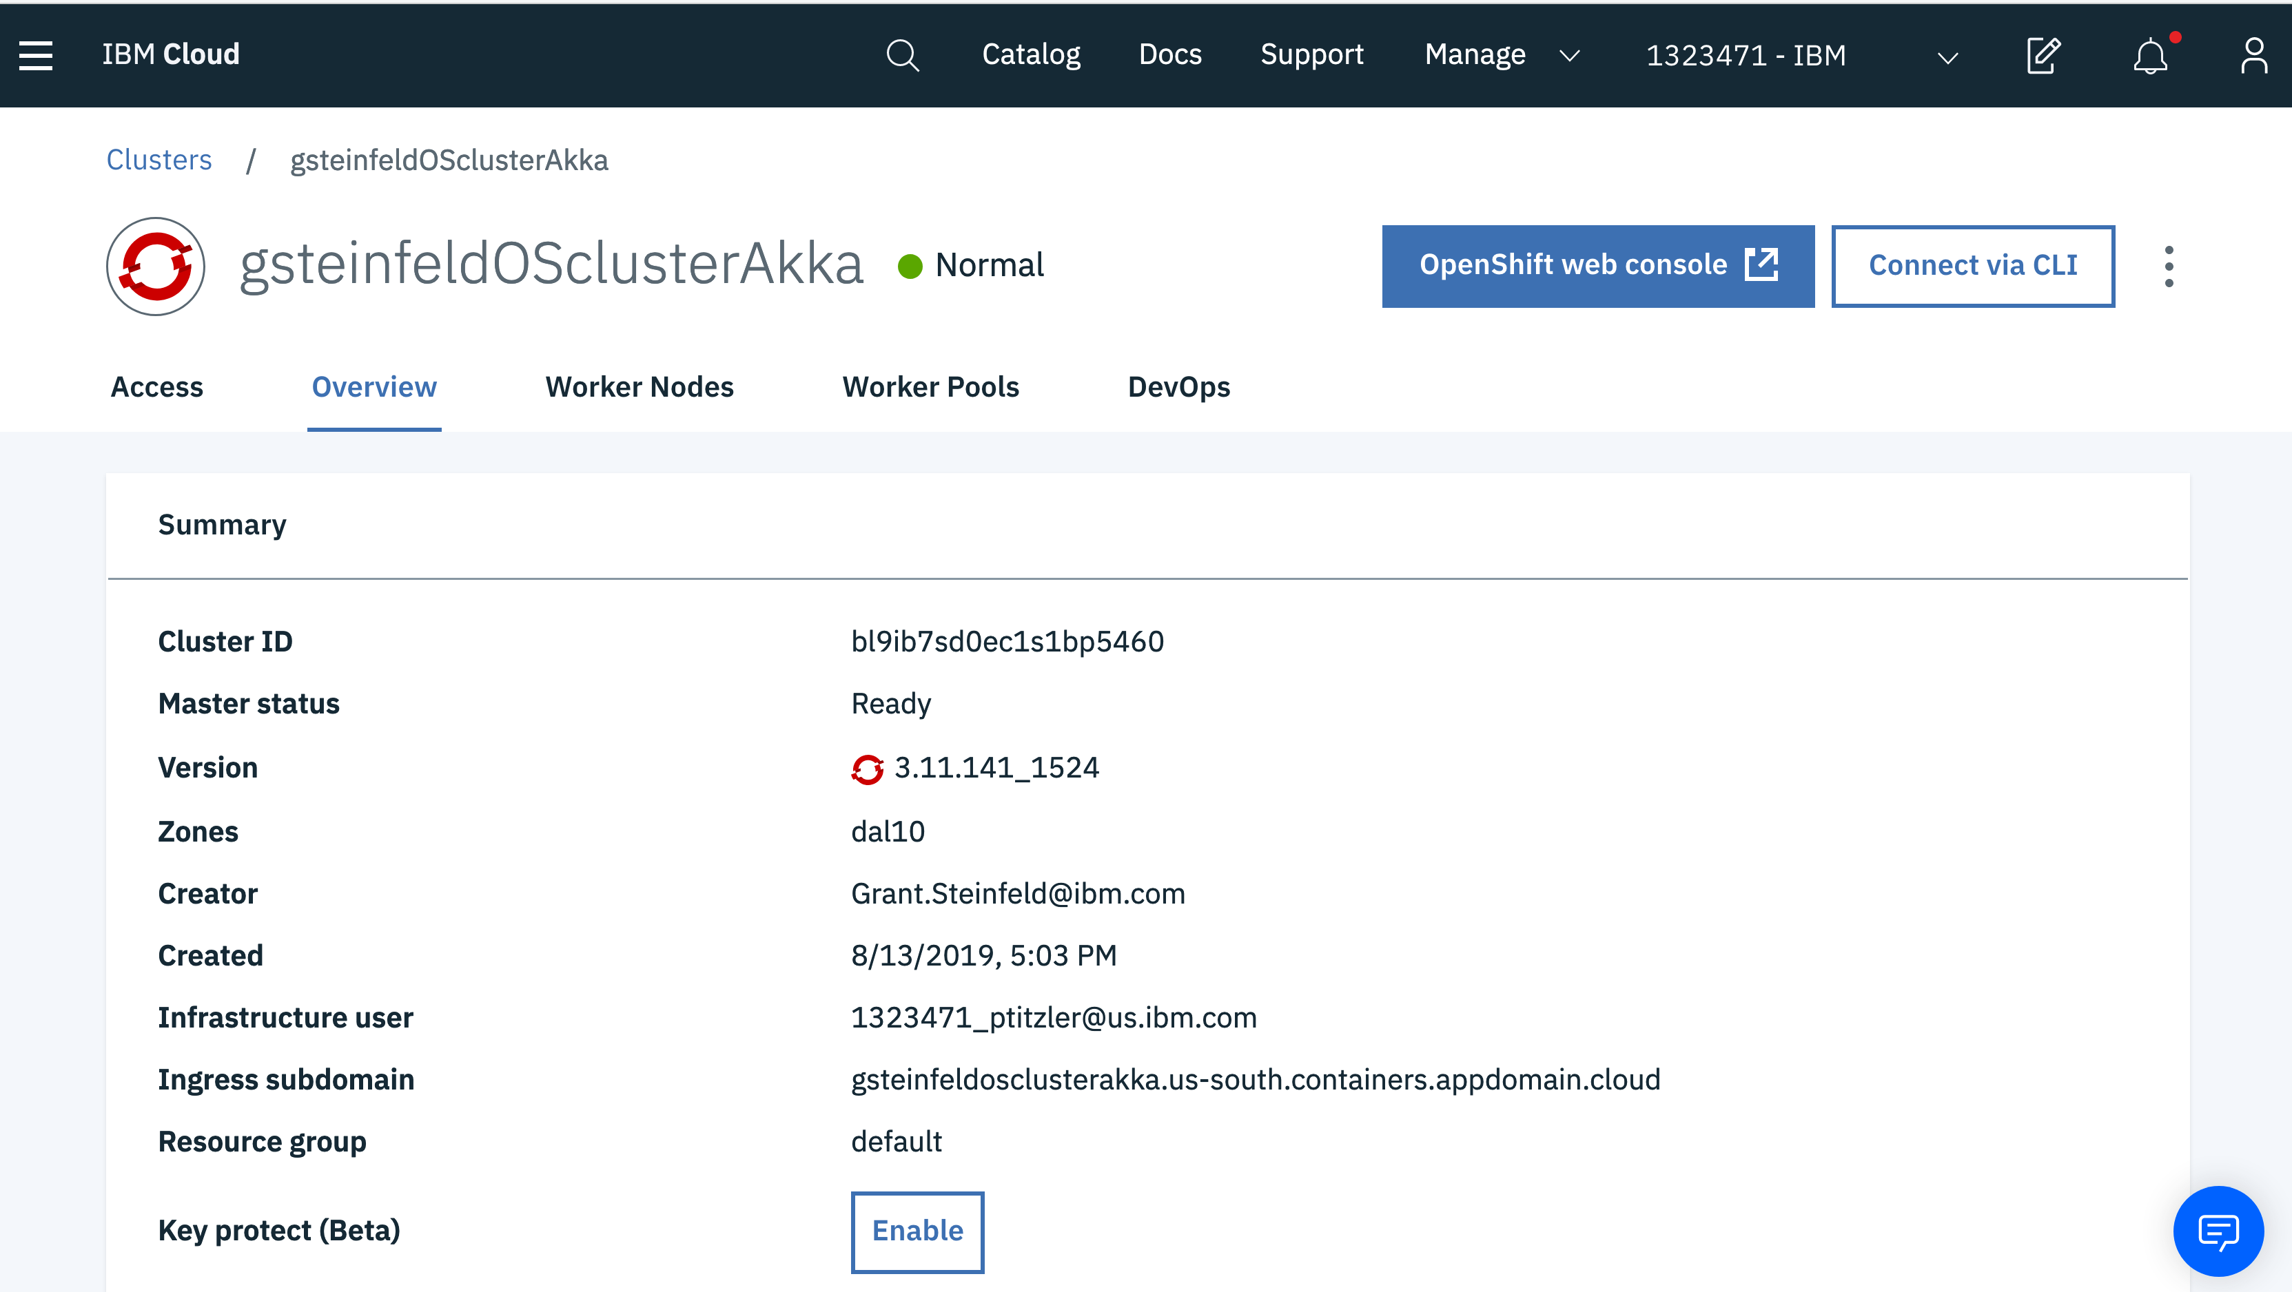

Slide 70
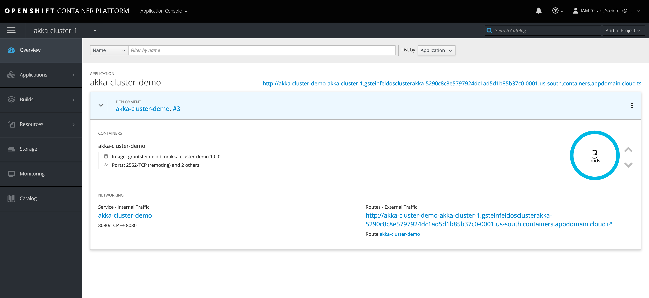

Slide 71
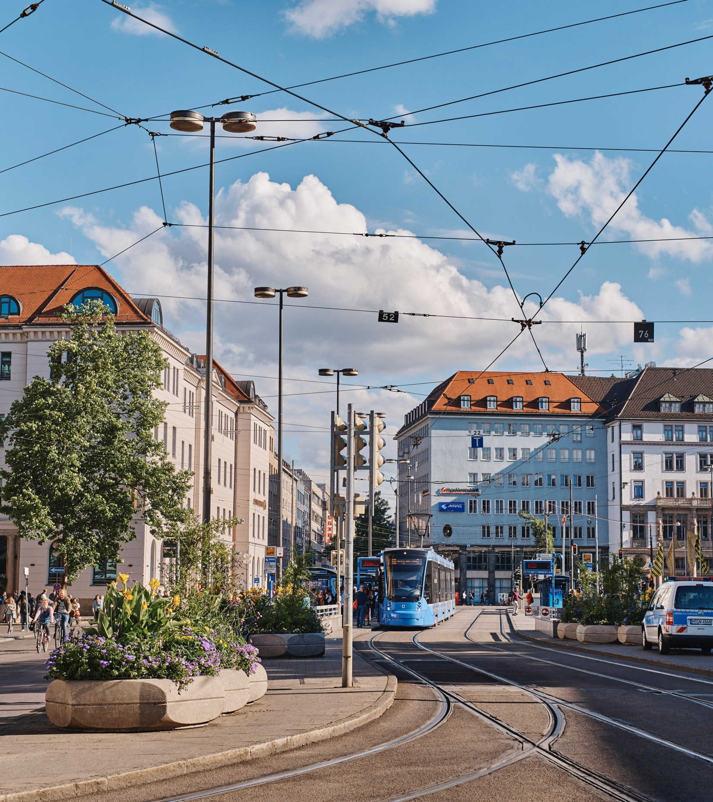
Q&A

Slide 72
Resources full demo code in this presentation https://github.ibm.com/mary-grygleski/vtcc_akka_helloworld - Mary Grygleski https://github.com/mckeeh3/akka-java-cluster-kubernetes - Hugh McKee Reactive Architecture and programming https://developer.ibm.com/technologies/reactive-systems/ https://www.reactivemanifesto.org/ Actor Model of Computation - Scalable Robust Information Systems Carl Hewitt https://arxiv.org/ftp/arxiv/papers/1008/1008.1459.pdf Akka Actors https://doc.akka.io/docs/akka/current/actors.html How Akka Works: 'At Most Once' Message Delivery – Hugh McKee https://www.lightbend.com/blog/how-akka-works-at-most-once-message-delivery

Slide 73
Resources Reactive Microsystems - The Evolution Of Microservices At Scale: Free O'Reilly Report By Jonas Bonér https://www.lightbend.com/blog/reactive-microsystems-the-evolution-of-microservices-at-scale-free-oreilly-report-by-jonas-boner Akka Cookbook by Piyush Mishra, Héctor Veiga Ortiz https://www.oreilly.com/library/view/akka-cookbook/9781785288180/ CQRS/EVENT SOURCING https://martinfowler.com/bliki/CQRS.html - Martin Fowler https://cqrs.files.wordpress.com/2010/11/cqrs_documents.pdf - Greg Young Minishift https://www.okd.io/minishift/ IBM OpenShift https://www.ibm.com/cloud/openshift

Slide 74
Resources Supervision Priciples in Erlang http://erlang.org/documentation/doc-4.9.1/doc/design_principles/sup_princ.html Akka Cookbook by Piyush Mishra, Héctor Veiga Ortiz https://www.oreilly.com/library/view/akka-cookbook/9781785288180/ CQRS/EVENT SOURCING https://martinfowler.com/bliki/CQRS.html - Martin Fowler https://cqrs.files.wordpress.com/2010/11/cqrs_documents.pdf - Greg Young Minishift https://www.okd.io/minishift/ IBM OpenShift https://www.ibm.com/cloud/openshift

Slide 75


Thank You!
@gsteinfeld
Sign up onto the IBM cloud platform to D with Red Hat OpenShift https://ibm.biz/Bdz239
https://github.com/grant-steinfeld
https://developer.ibm.com/profiles/grant.steinfeld
Get this presentation slide deck and more at
https://bit.ly/2lWwy36
@mgrygles
https://github.com/mgrygles
https://developer.ibm.com/profiles/mary.grygleski

